Slide 1
Chapter 5 Control Statements: Part 2

Slide 2
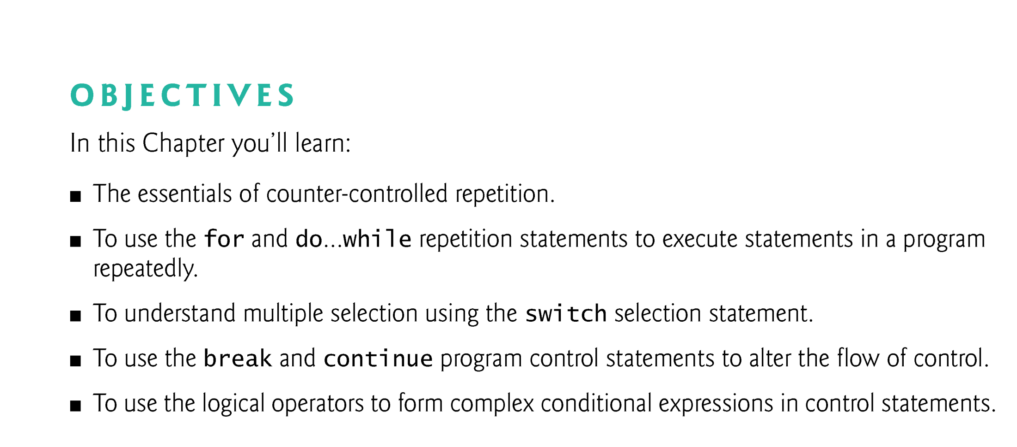

Slide 3
5.1 Introduction
for repetition statement
do…while repetition statement
switch multiple-selection statement
break statement
continue statement
Logical operators
Control statements summary.

Slide 4
5.2 Essentials of Counter-Controlled Repetition
Counter-controlled repetition requires
a control variable (or loop counter)
the initial value of the control variable
the increment (or decrement) by which the control variable is modified each time through the loop (also known as each iteration of the loop)
the loop-continuation condition that determines if looping should continue.

Slide 5
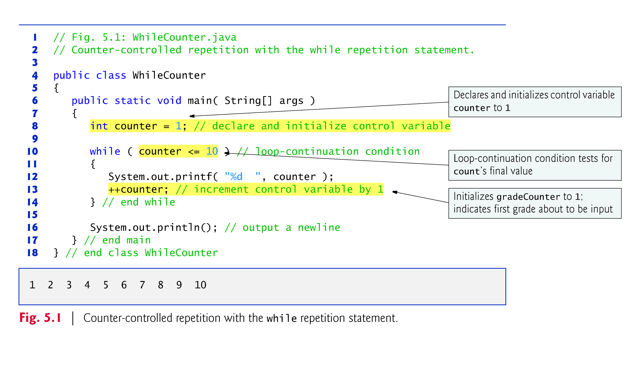

Slide 6
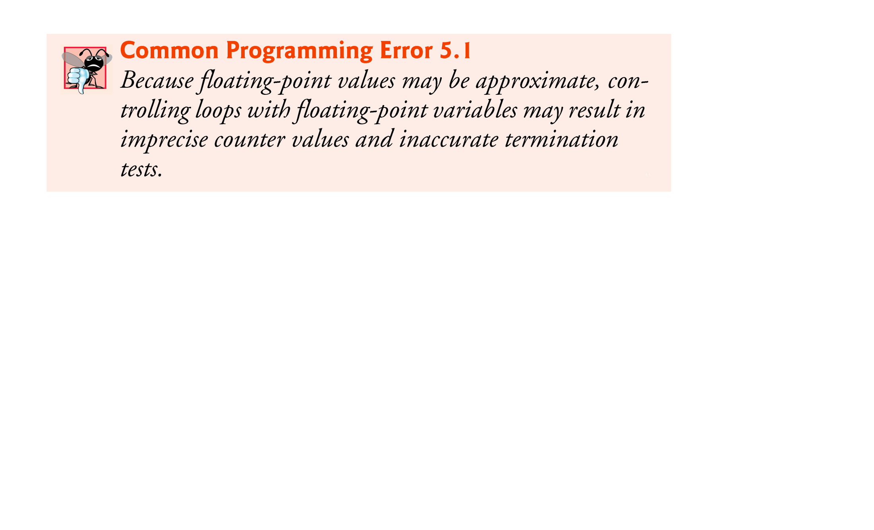
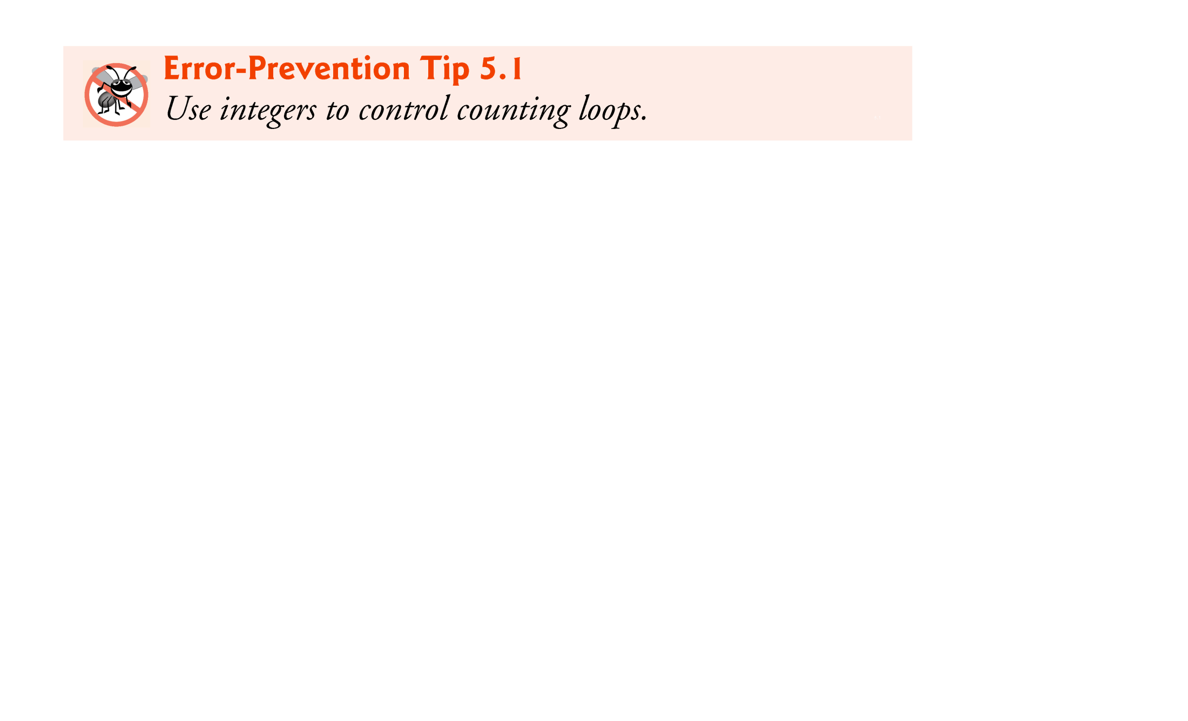
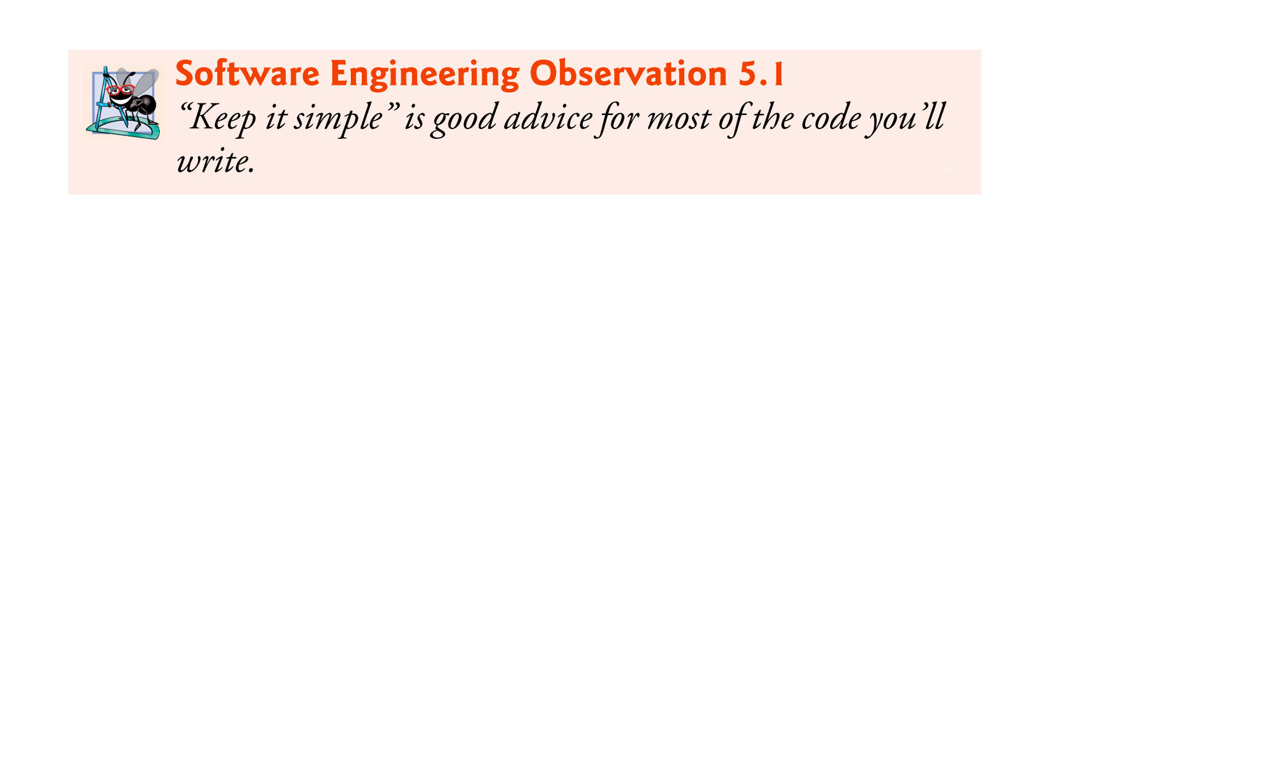

Slide 7
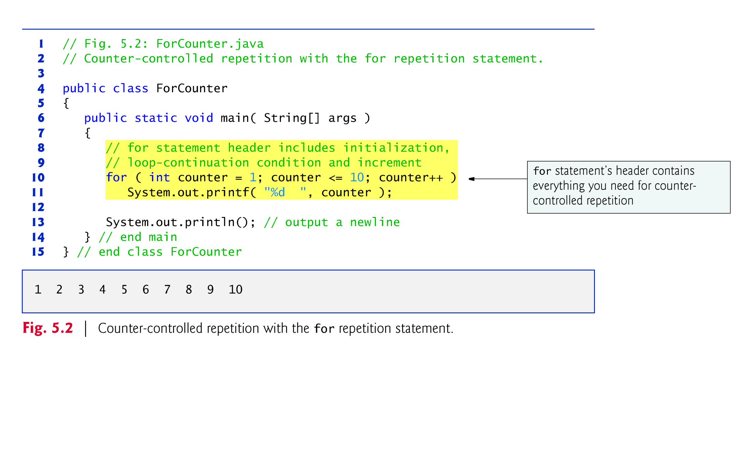
5.3 for Repetition Statement
for repetition statement

Slide 8
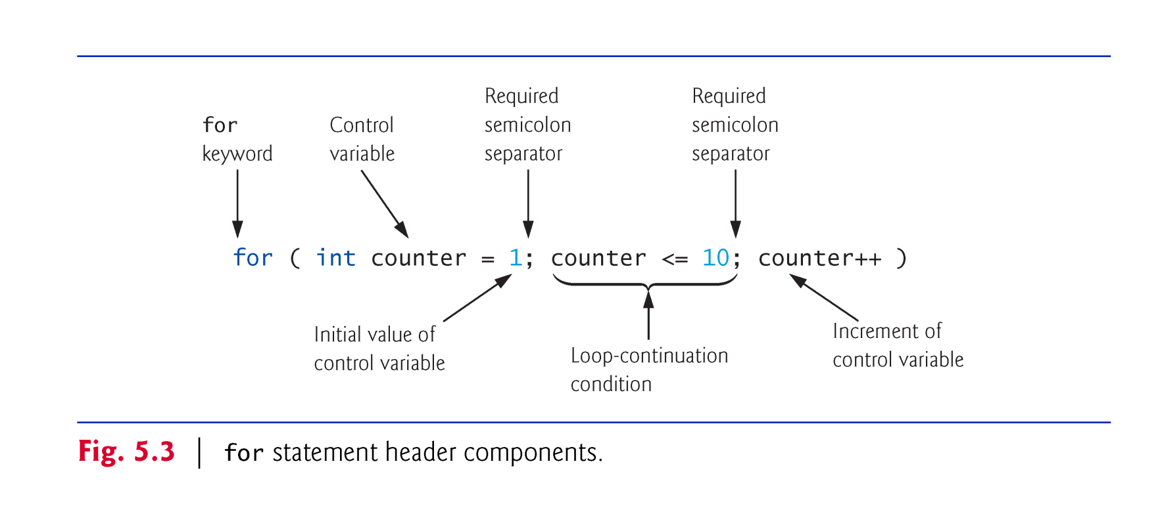

Slide 9
5.3 for Repetition Statement (Cont.)
The general format of the for statement is
for ( initialization; loopContinuationCondition; increment ) statement
the initialization expression names the loop’s control variable and optionally provides its initial value
loopContinuationCondition determines whether the loop should continue executing
increment modifies the control variable’s value (possibly an increment or decrement), so that the loop-continuation condition eventually becomes false.
The two semicolons in the for header are required.
All three expressions in a for header are optional.

Slide 10
5.3 for Repetition Statement (Cont.)
In most cases, the for statement can be represented with an equivalent while statement as follows:
initialization;
while ( loopContinuationCondition ) { statement increment; }
Typically, for statements are used for counter-controlled repetition and while statements for sentinel-controlled repetition.
If the initialization expression in the for header declares the control variable, the control variable can be used only in that for statement.

Slide 11
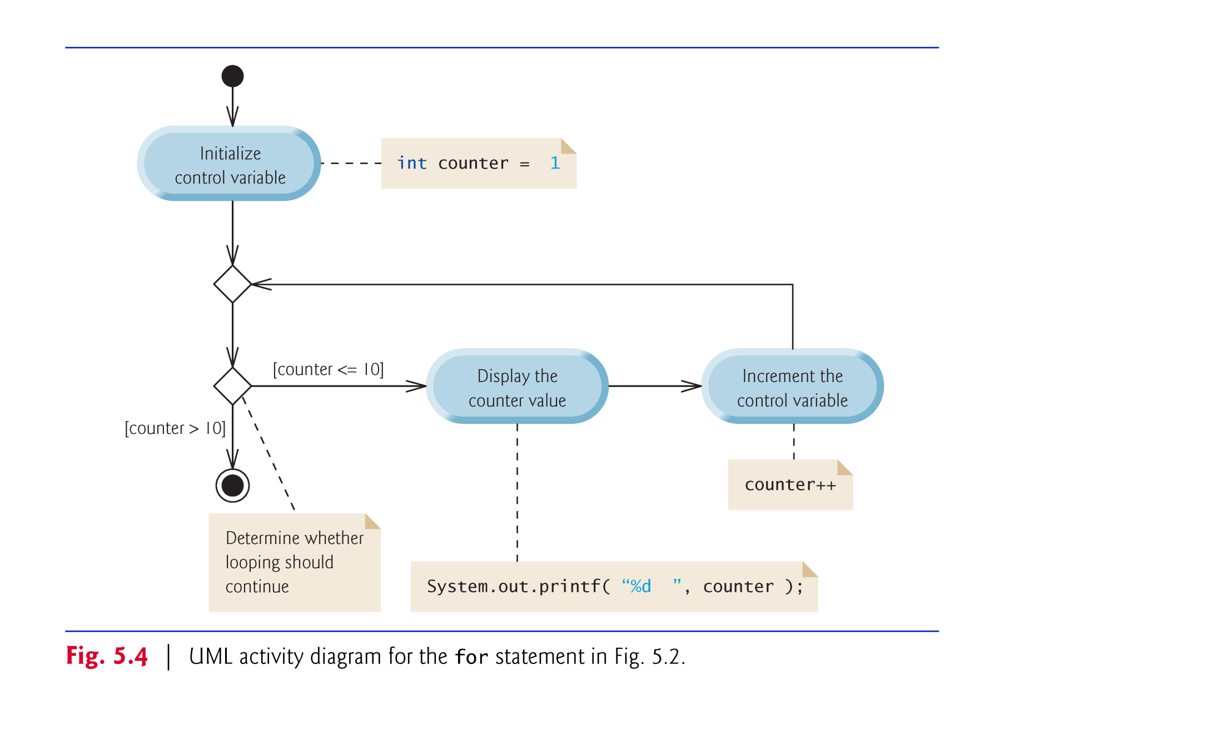

Slide 12
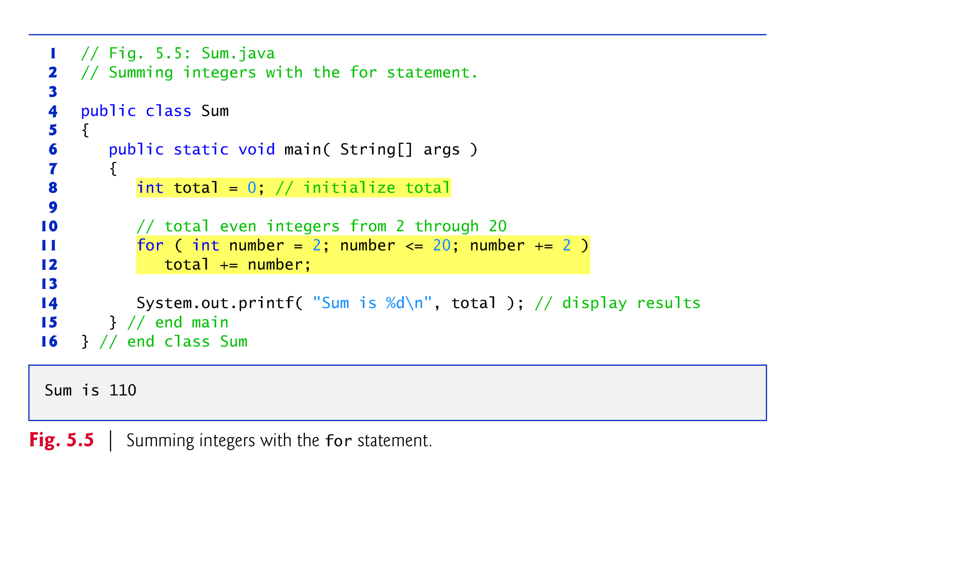

Slide 13
5.3 for Repetition Statement (Cont.)
Examples
for (int j = x; j <= 4 * x * y; j += y / x) {…}
for (int j = 2; j <= 80; j += 5) {…}
for ( int i = 100; i >= 1; i-- ){…}
for ( int number = 2; number <= 20; total += number, number += 2 ) ; // empty statement

Slide 14
5.4 Examples Using the for Statement (Cont.)
Compound interest application
A person invests $1000 in a savings account yielding 5% interest. Assuming that all the interest is left on deposit, calculate and print the amount of money in the account at the end of each year for 10 years. Use the following formula to determine the amounts:
a = p (1 + r)^{n}
where
p is the original amount invested (i.e., the principal) r is the annual interest rate (e.g., use 0.05 for 5%) n is the number of years a is the amount on deposit at the end of the nth year.

Slide 15
5.4 Examples Using the for Statement (Cont.)
The solution to this problem (Fig. 5.6) involves a loop that performs the indicated calculation for each of the 10 years the money remains on deposit.
Java treats floating-point constants like 1000.0 and 0.05 as type double.
Java treats whole-number constants like 7 and -22 as type int.

Slide 16
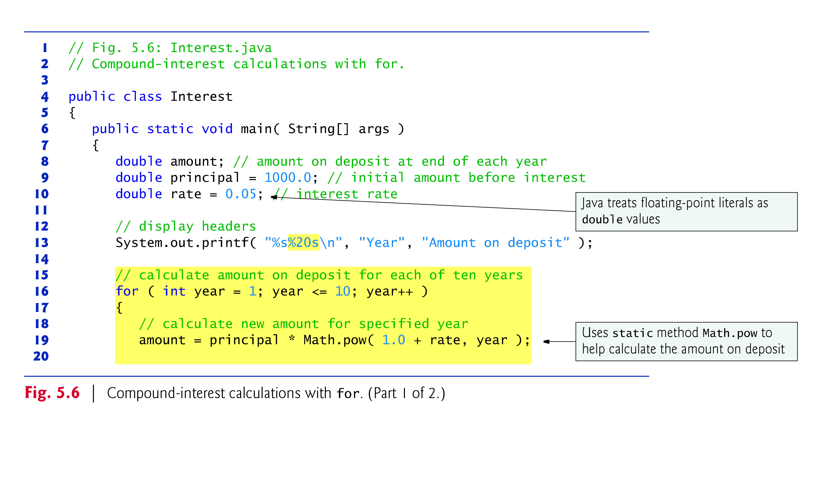

Slide 17
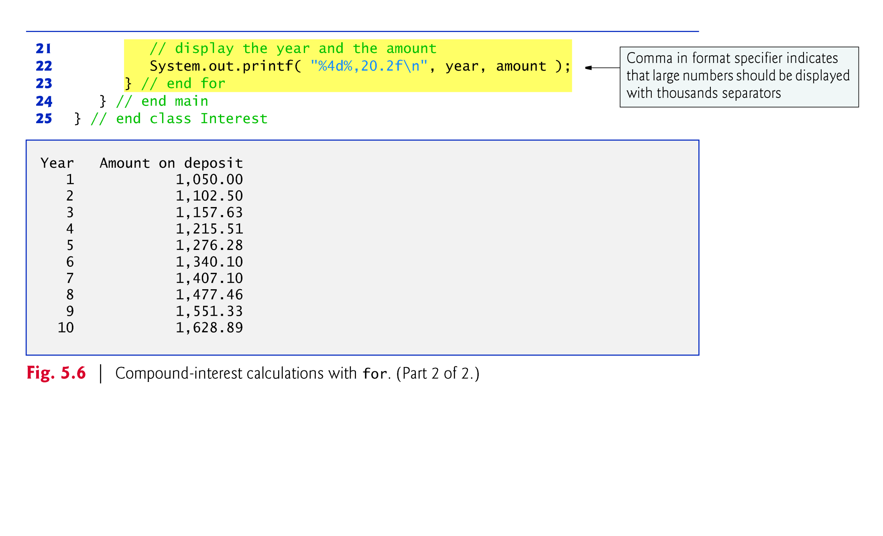

Slide 18
5.4 Examples Using the for Statement (Cont.)
In the format specifier %20s
20:
printf displays the value with at least 20 character positions.
right justified
To indicate that values should be output left justified, precede the field width with the minus sign (–) formatting flag (e.g., %-20s).

Slide 19
5.4 Examples Using the for Statement (Cont.)
Java does not include an exponentiation operator—Math class static method pow can be used for raising a value to a power.
You can call a static method by specifying the class name followed by a dot (.) and the method name, as in
ClassName.methodName( arguments )
Math.pow(x, y) calculates the value of x raised to the y^{th} power. The method receives two double arguments and returns a double value.

Slide 20
5.4 Examples Using the for Statement (Cont.)
In the format specifier %,20.2f
comma (,) formatting flag
indicates that the floating-point value should be output with a grouping separator.
Separator is specific to the user’s locale (i.e., country).
In the United States: 1,234.45.
.2
specifies the formatted number’s precision—in this case, the number is rounded to the nearest hundredth and output with two digits to the right of the decimal point.

Slide 21
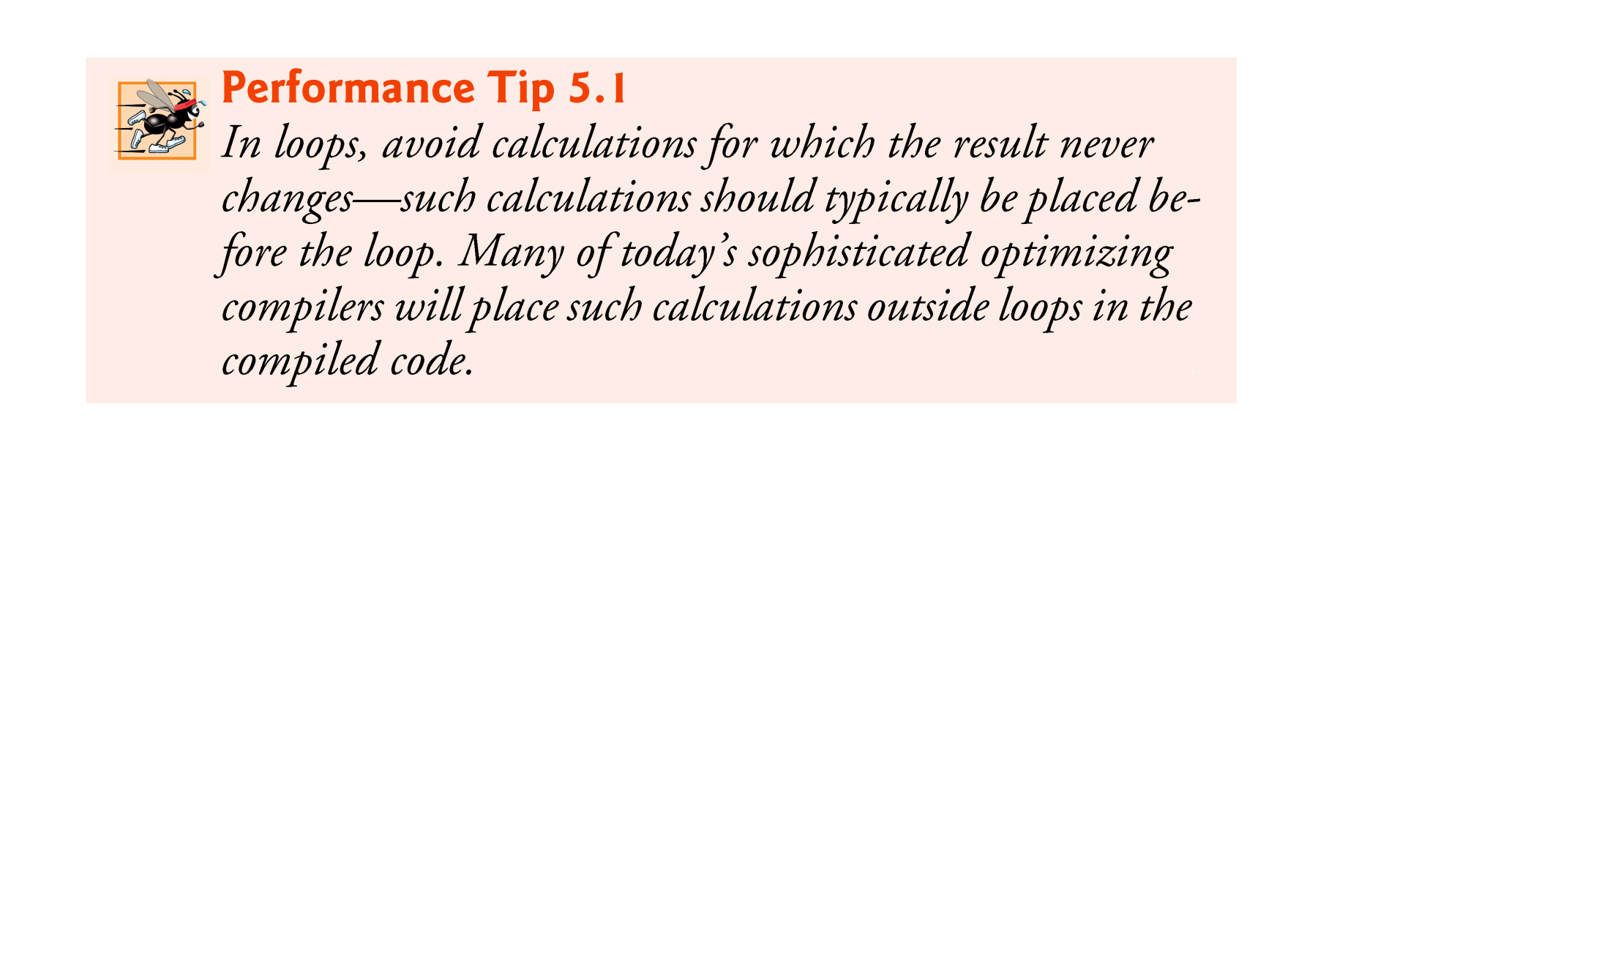

Slide 22
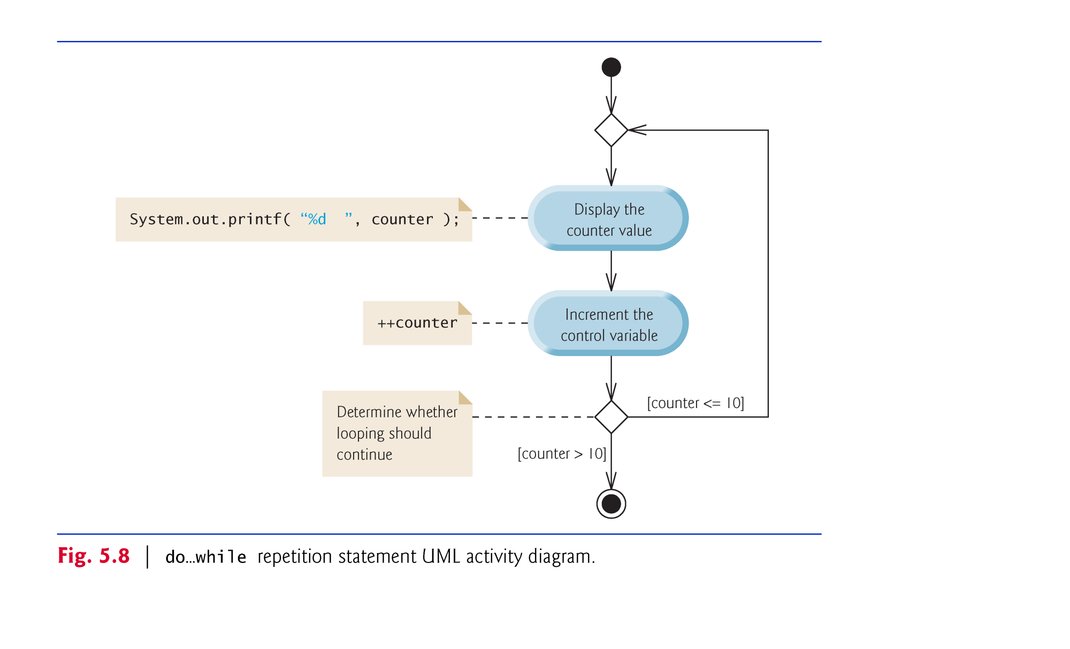
5.5 do…while Repetition Statement

Slide 23
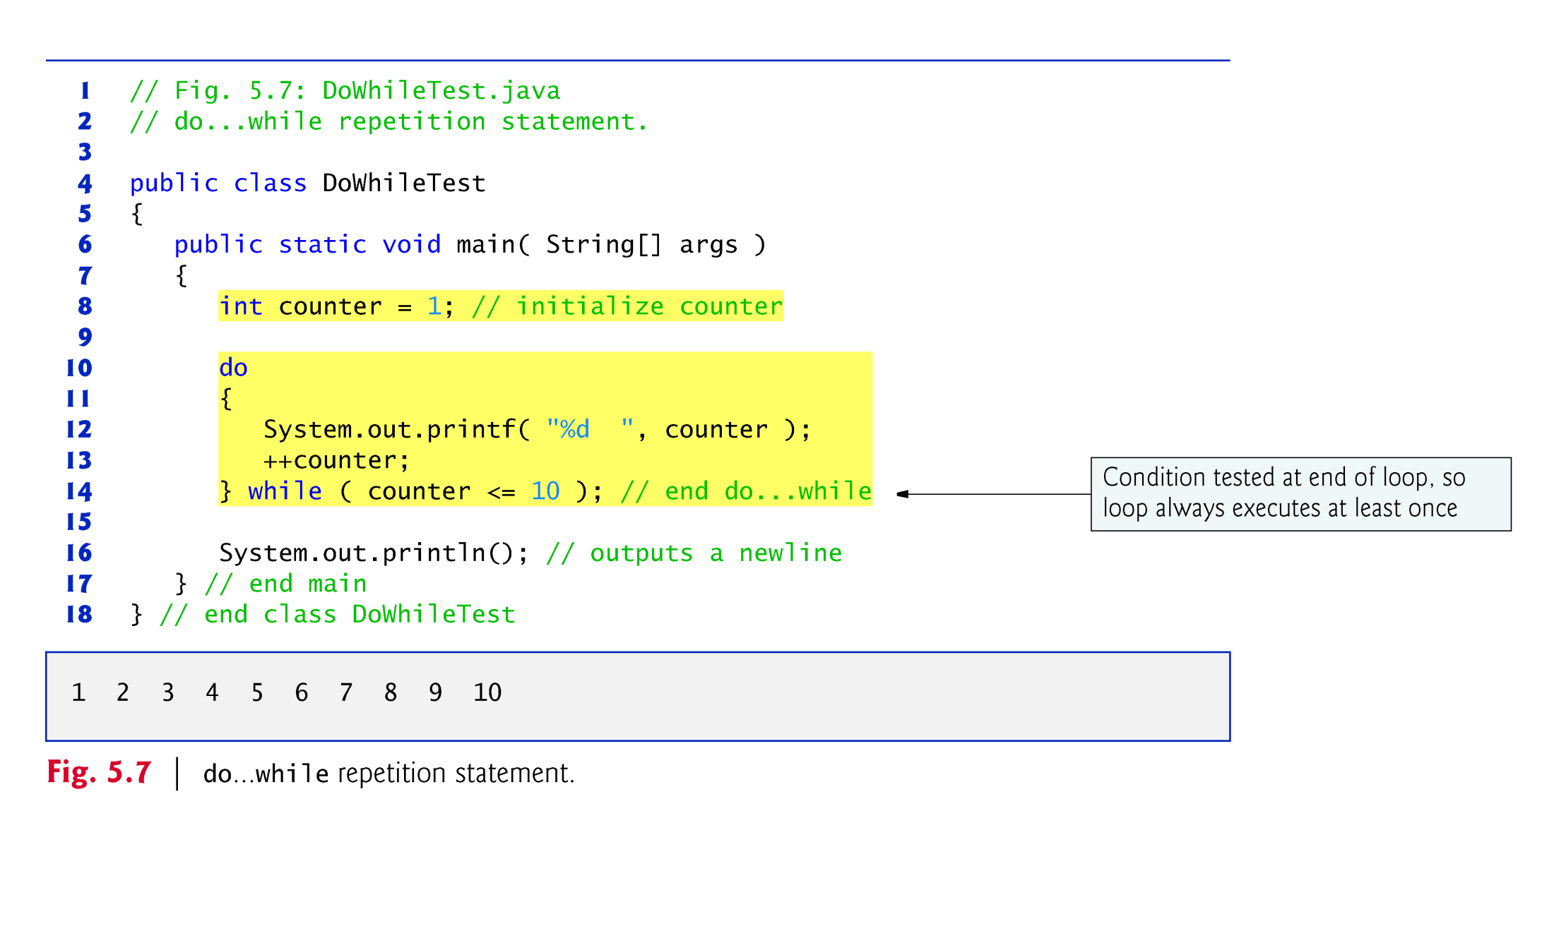

Slide 24
5.6 switch Multiple-Selection Statement
switch multiple-selection statement performs different actions based on the possible values of a constant integral expression of type byte, short, int or char. As of Java SE 7, the expression may also be a String.

Slide 25
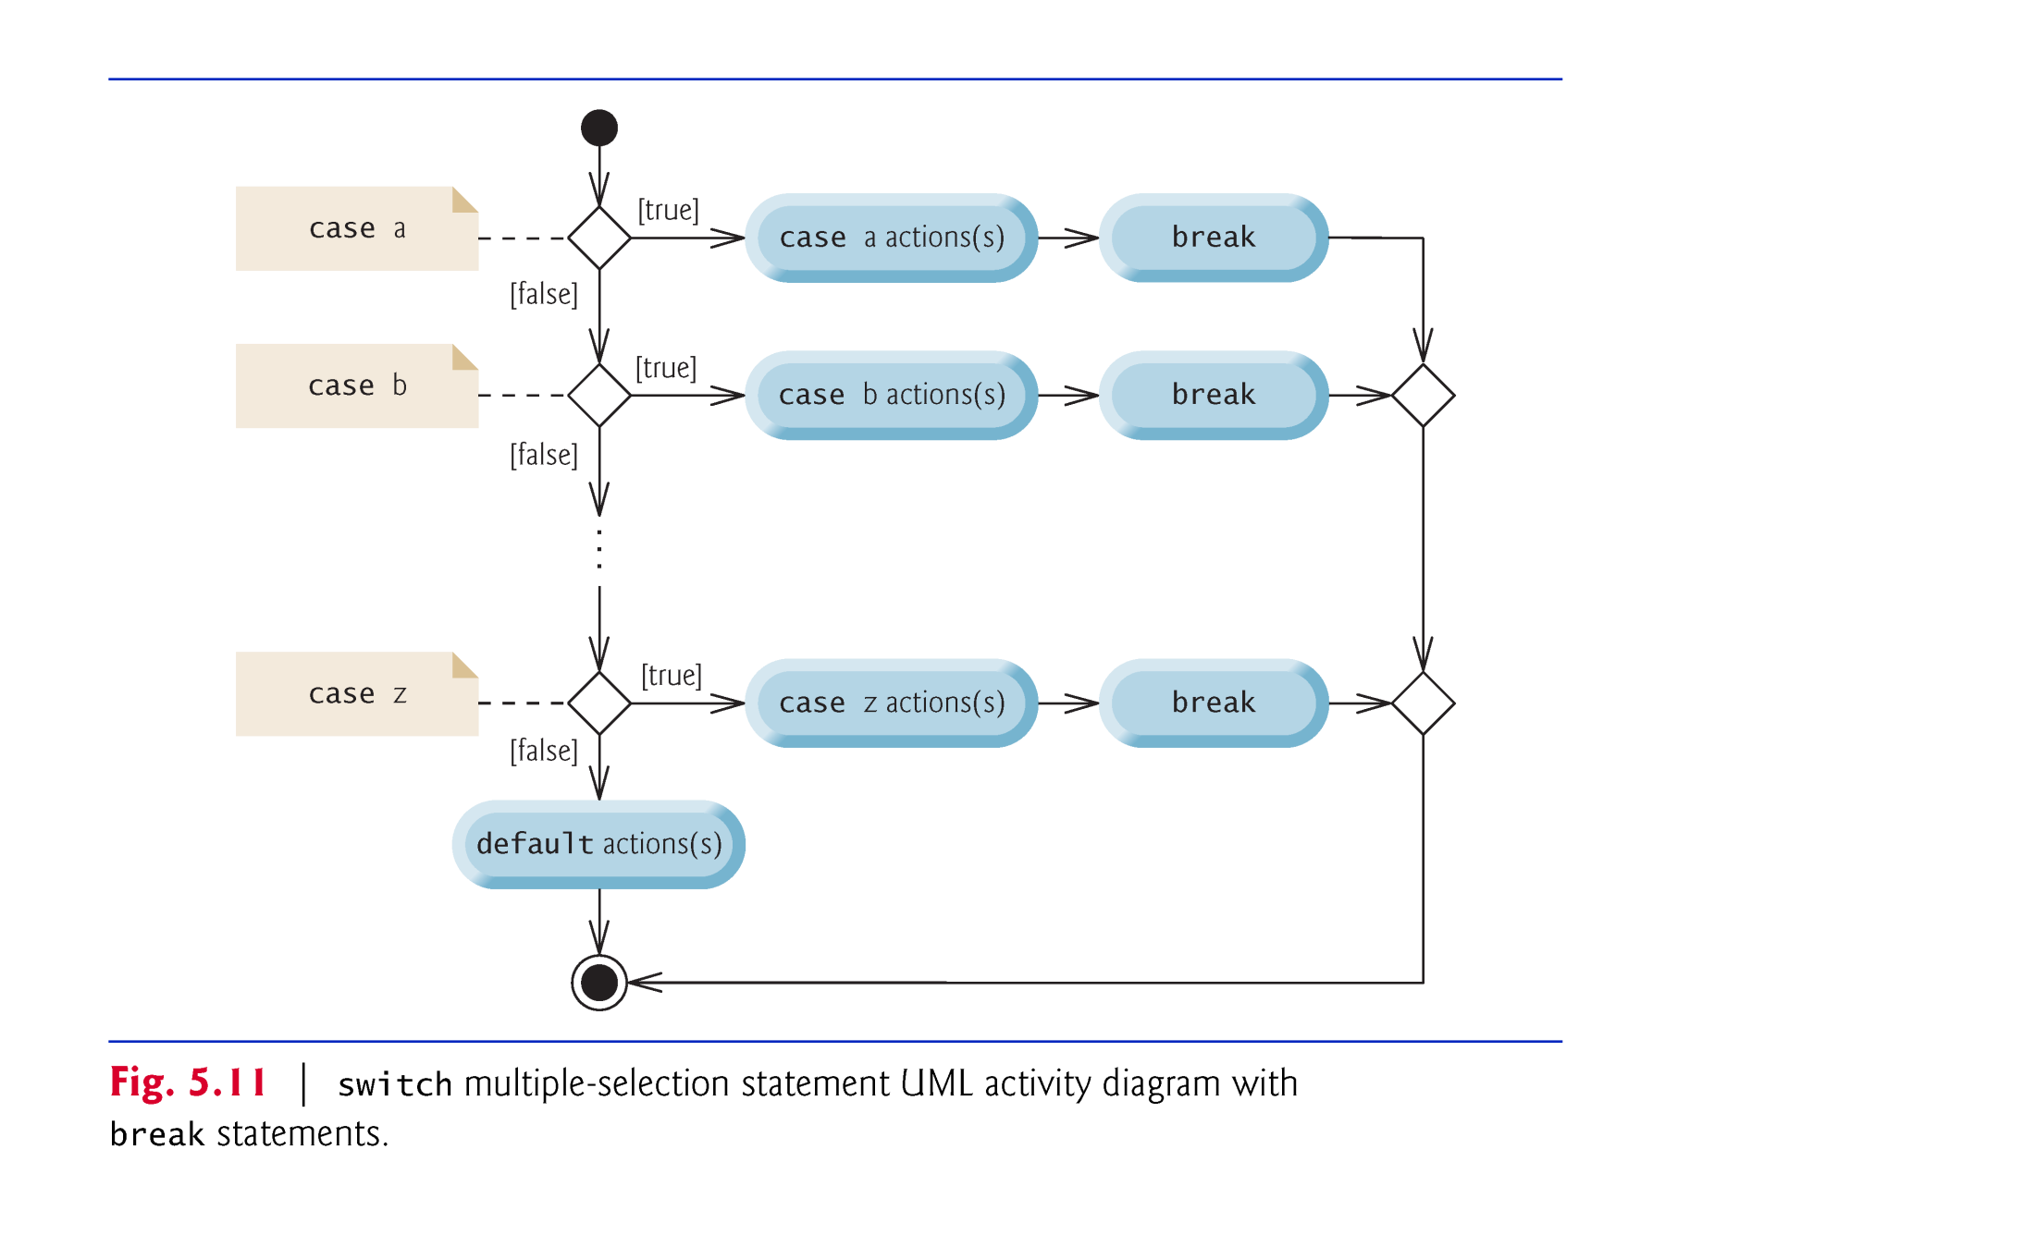

Slide 26
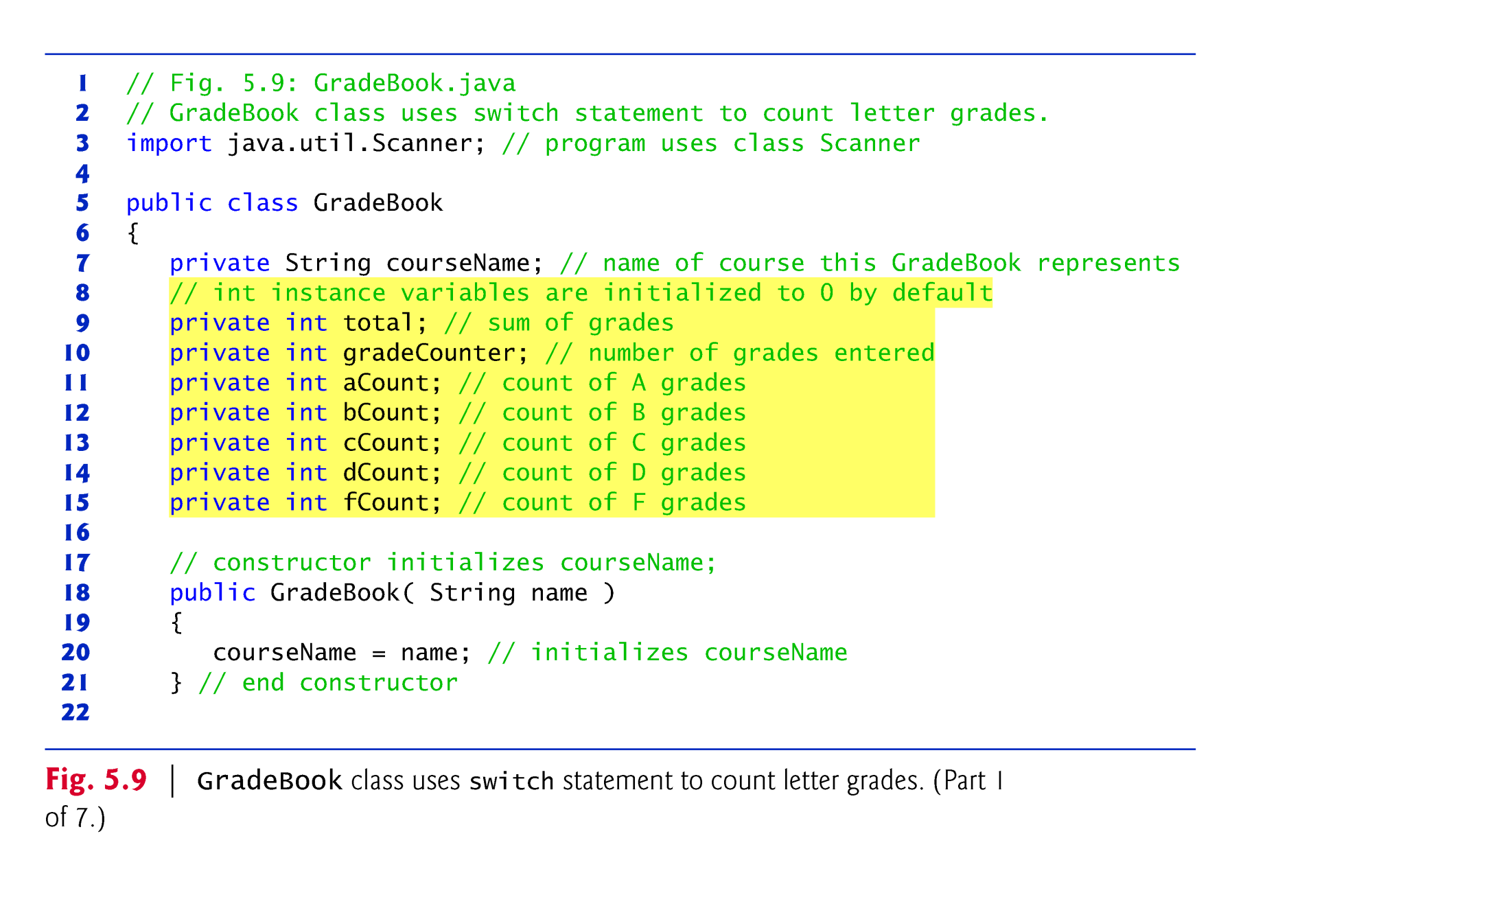

Slide 27
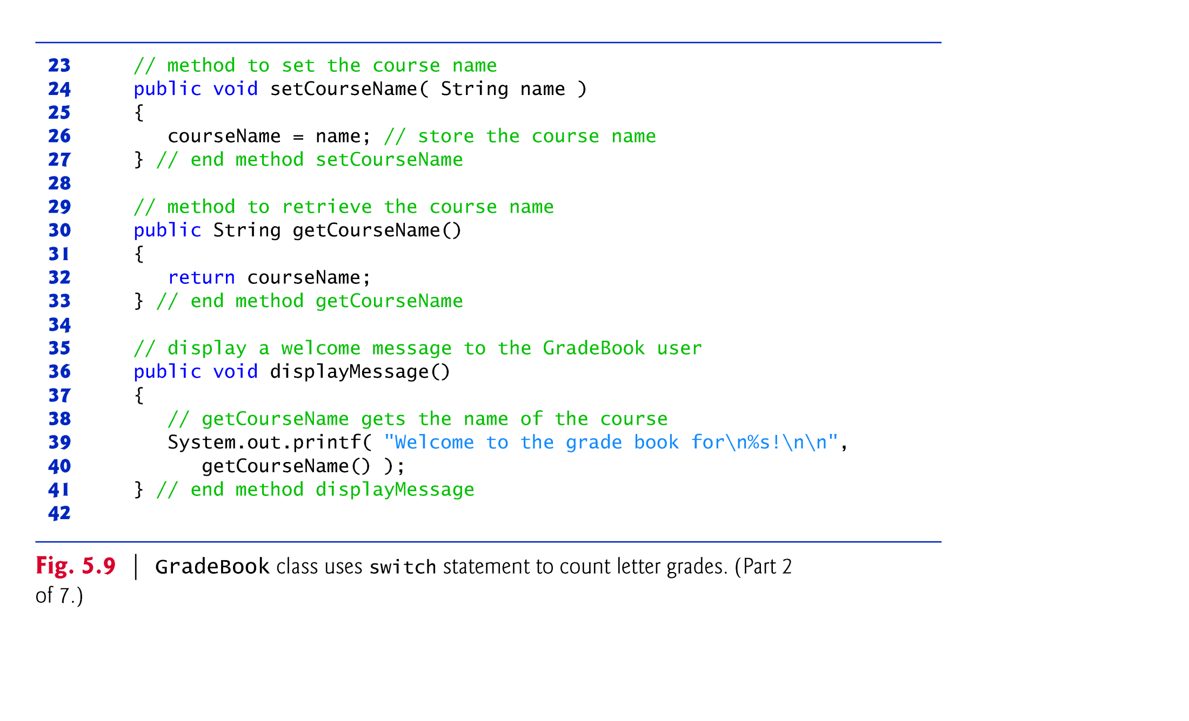

Slide 28
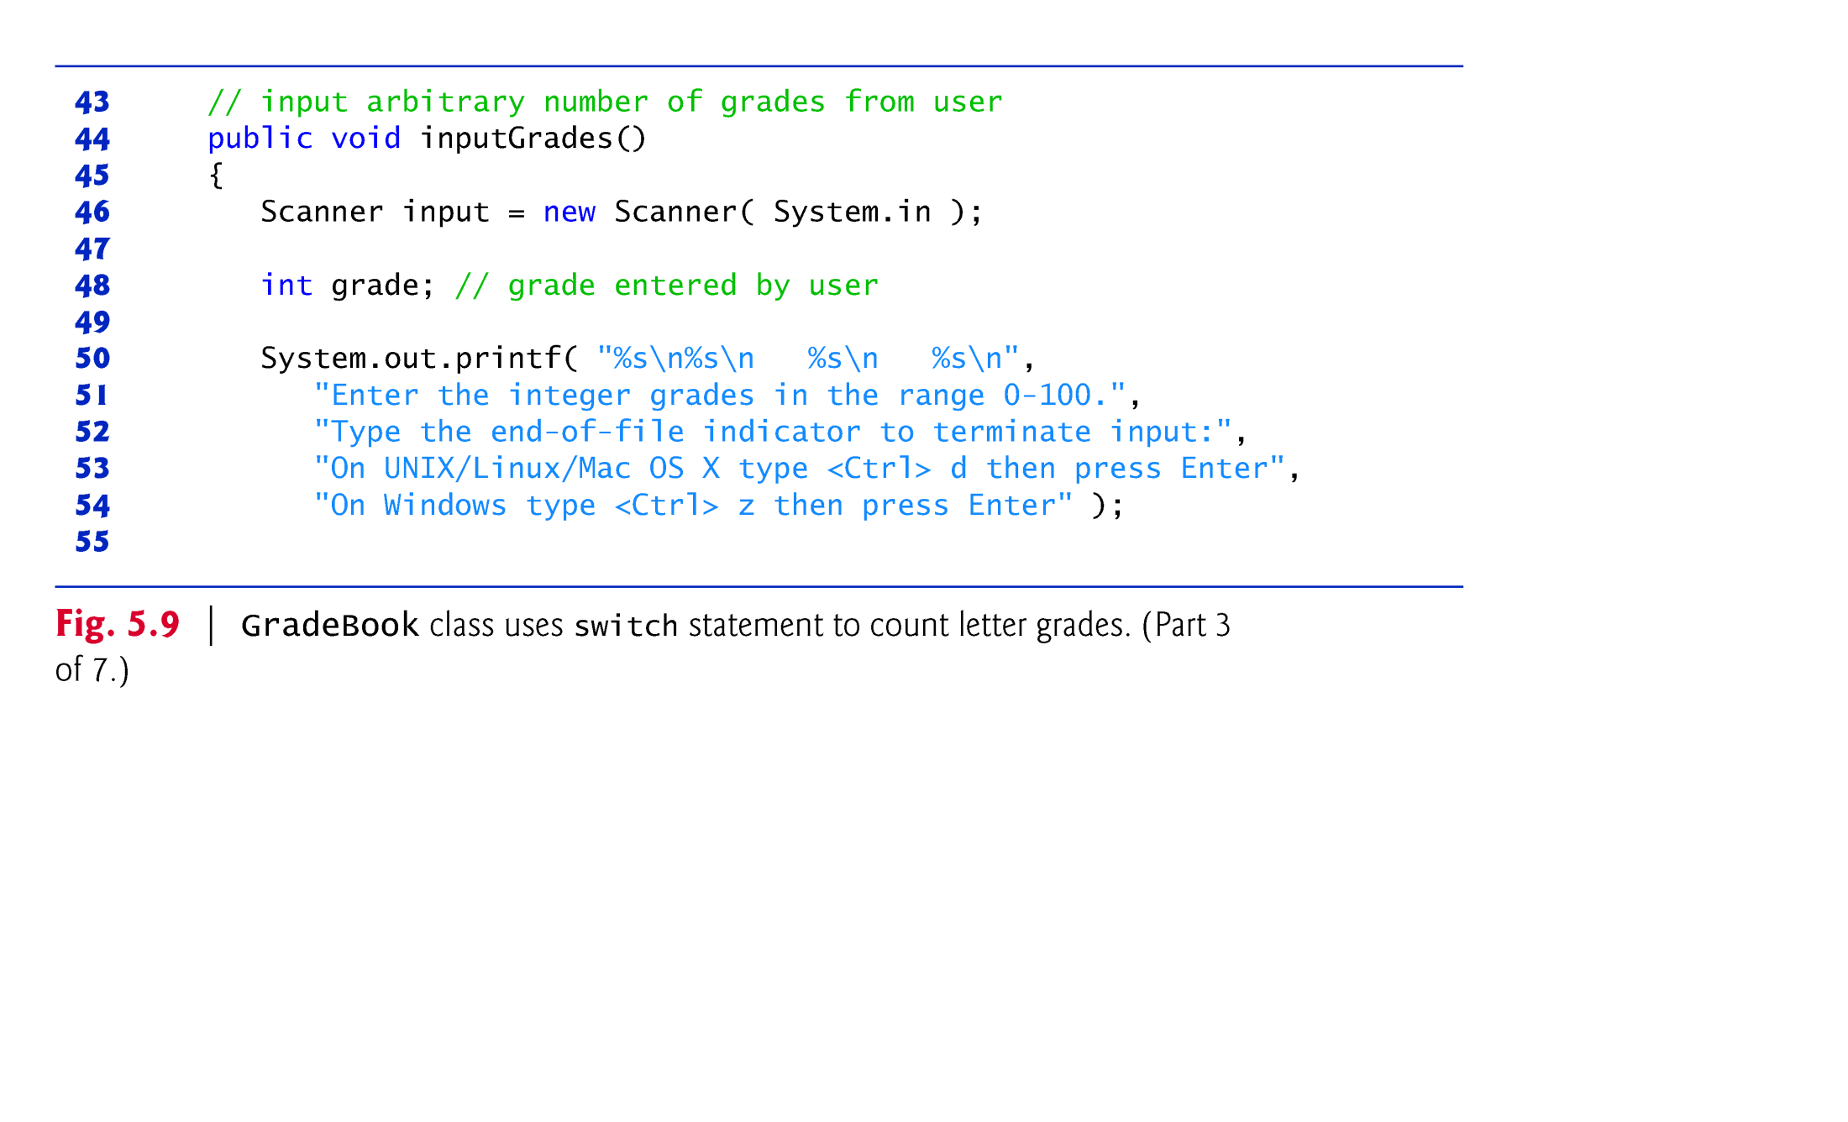

Slide 29
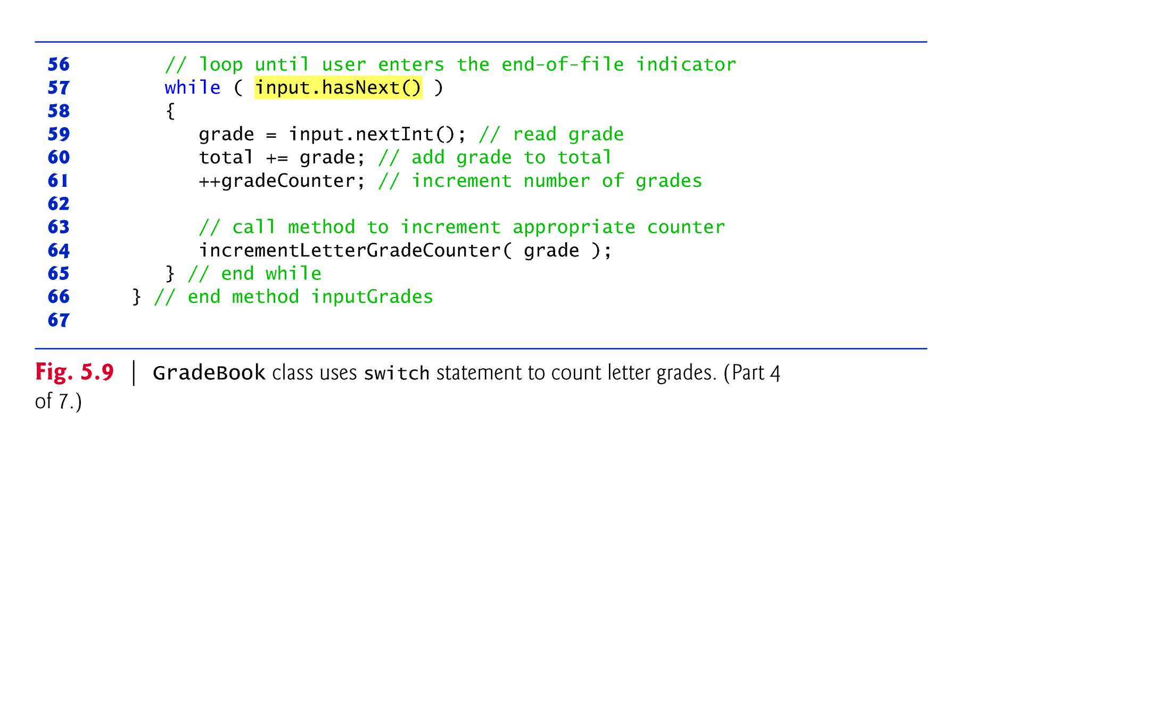

Slide 30
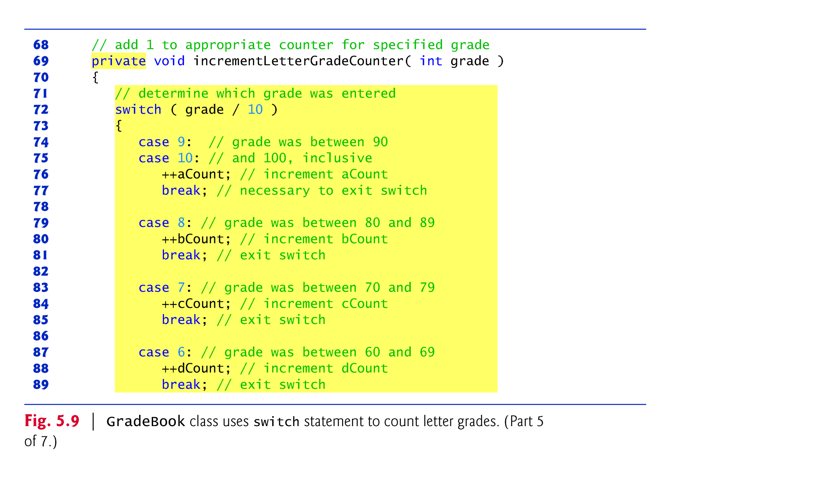

Slide 31
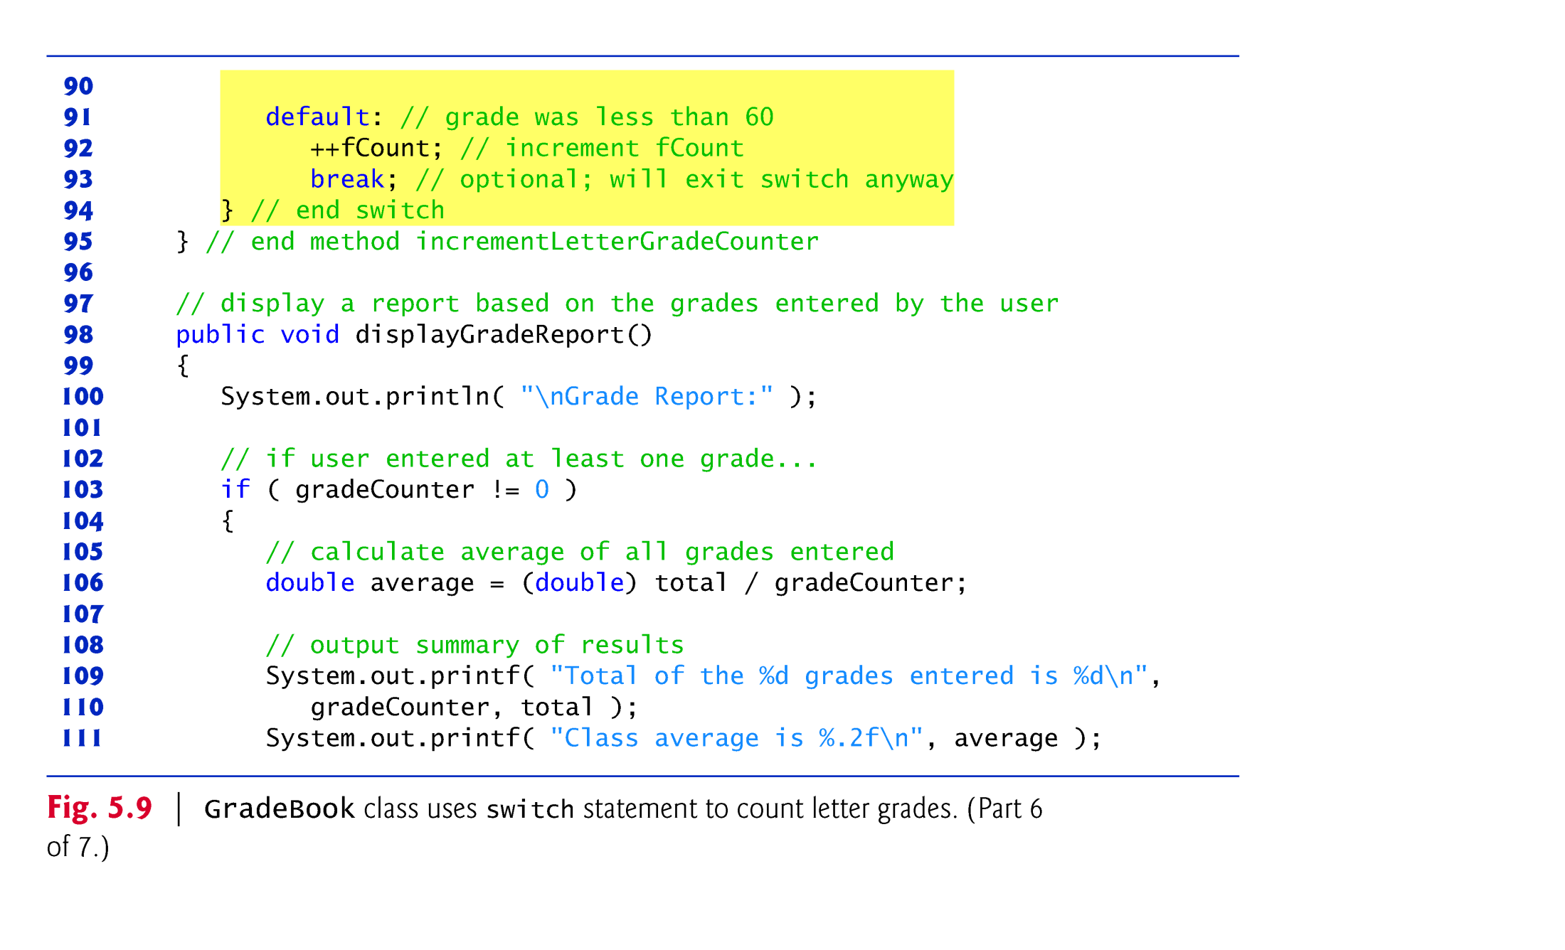

Slide 32
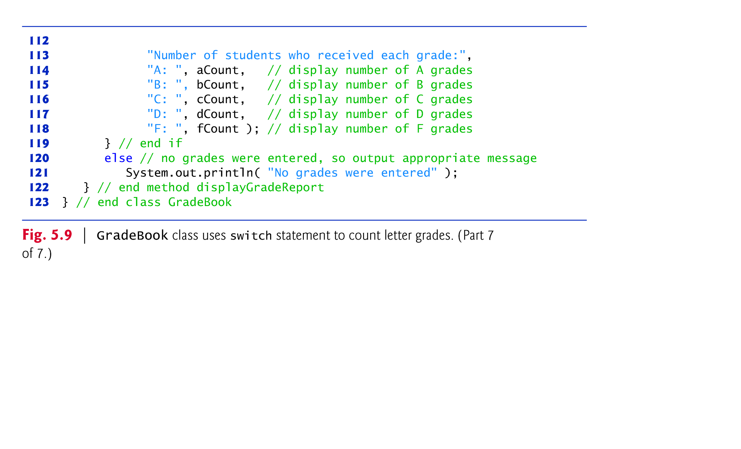

Slide 33
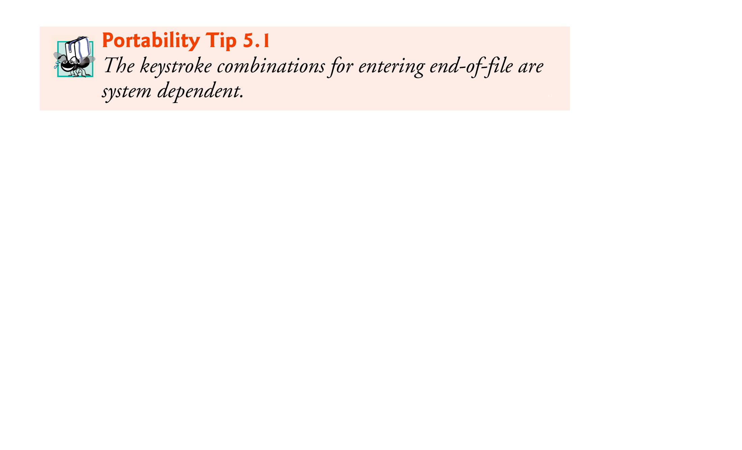


Slide 34
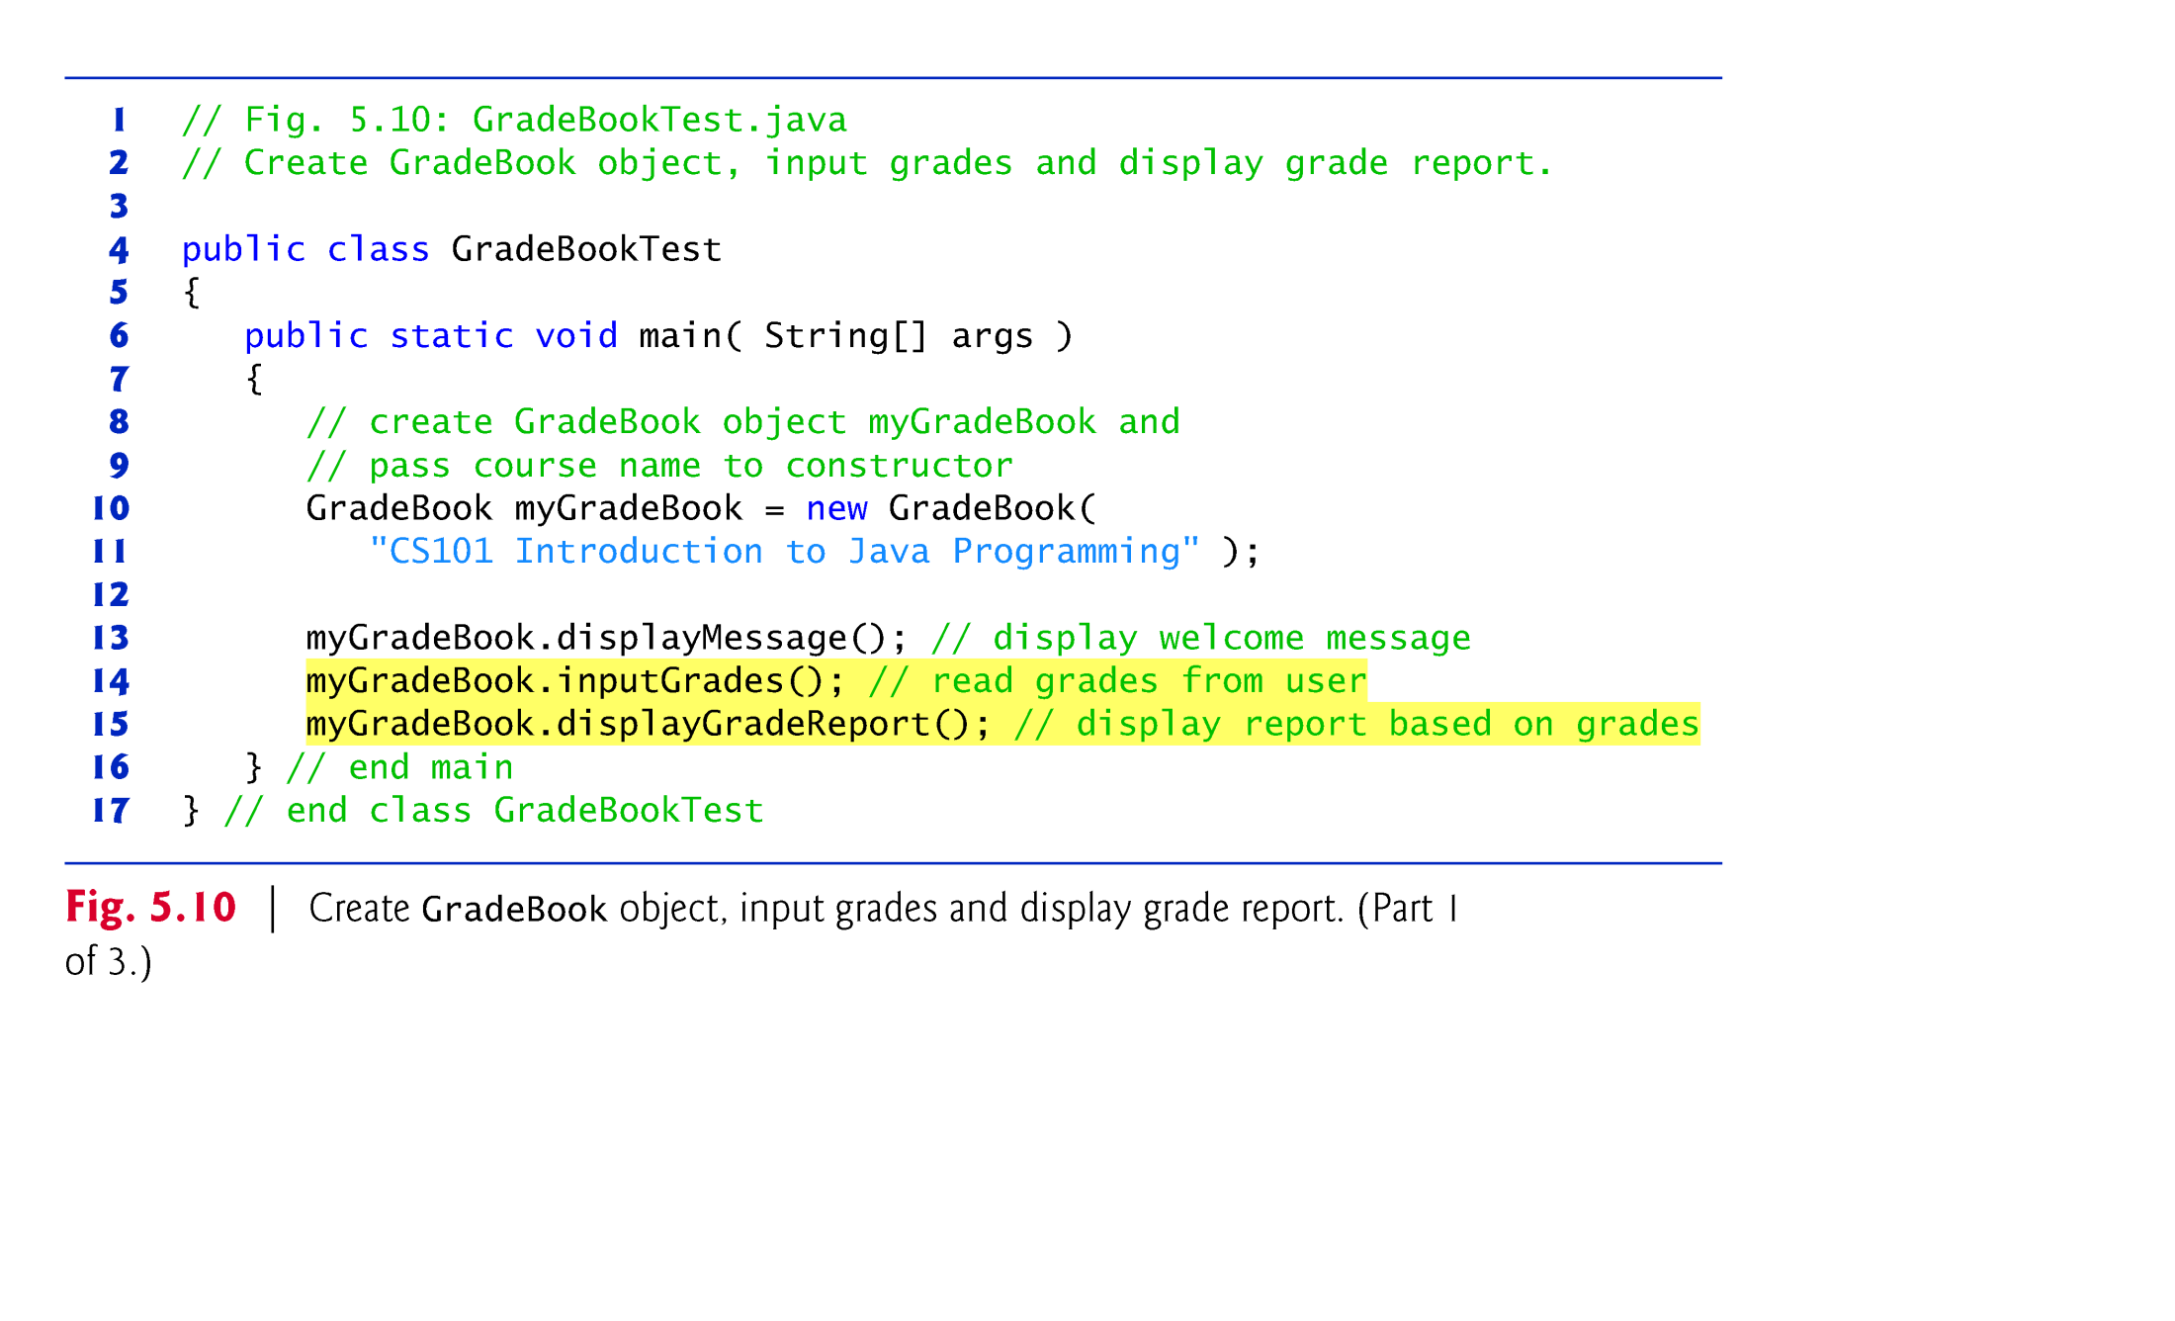

Slide 35
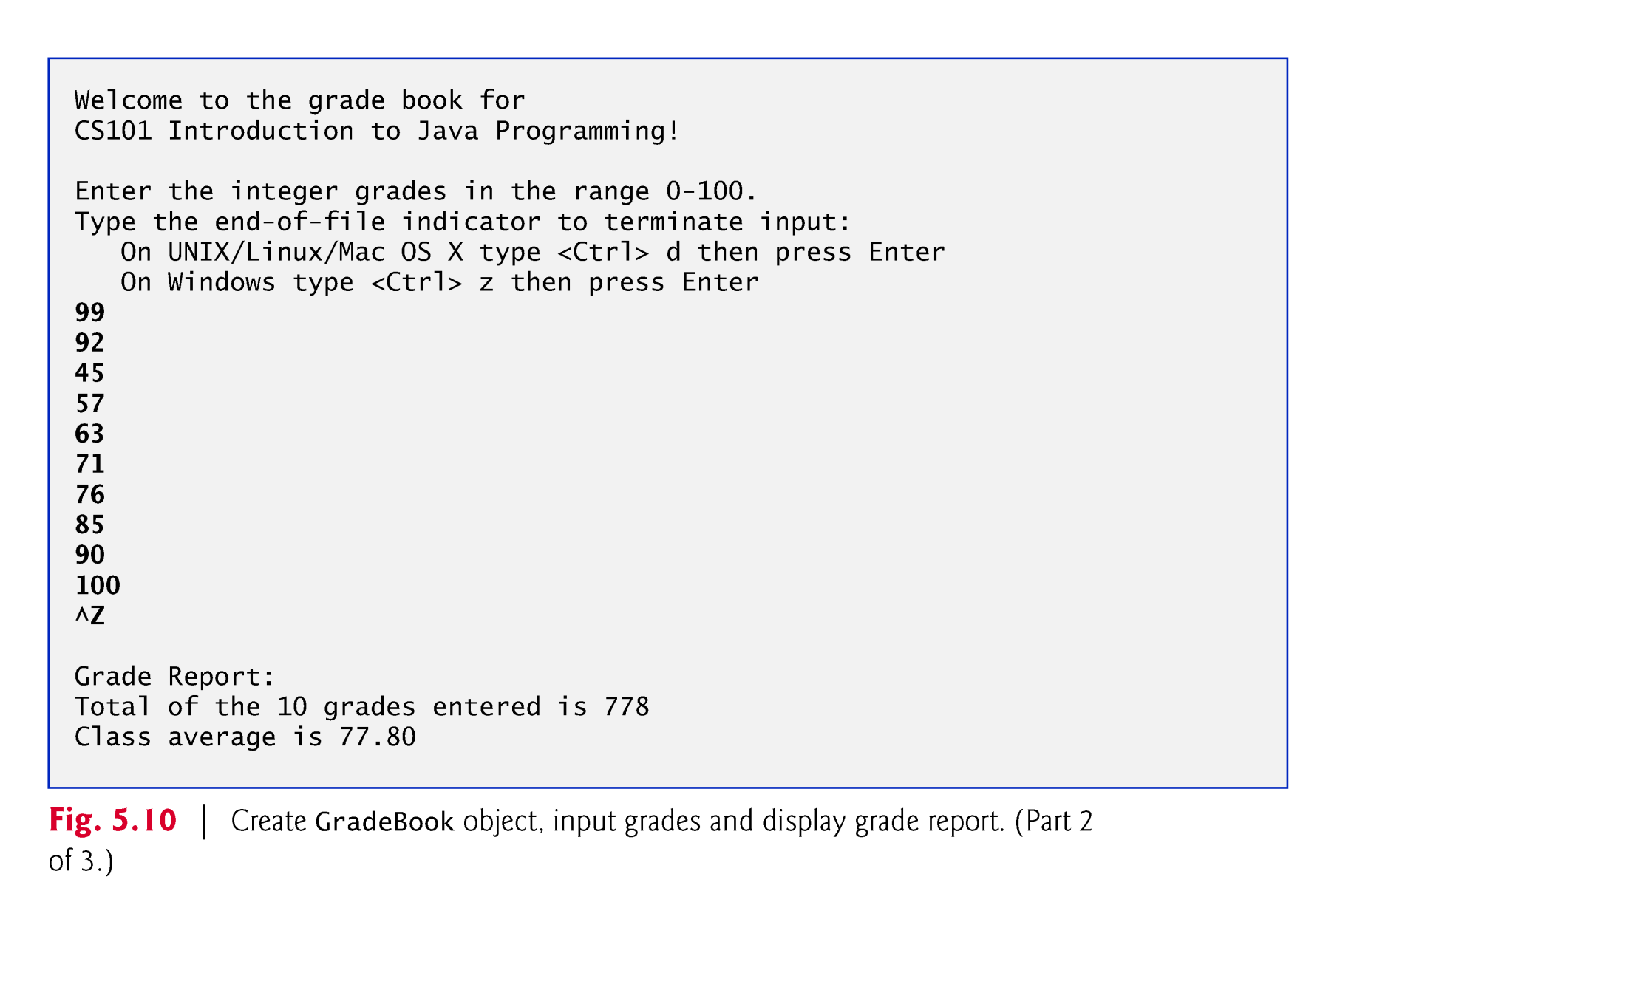

Slide 36
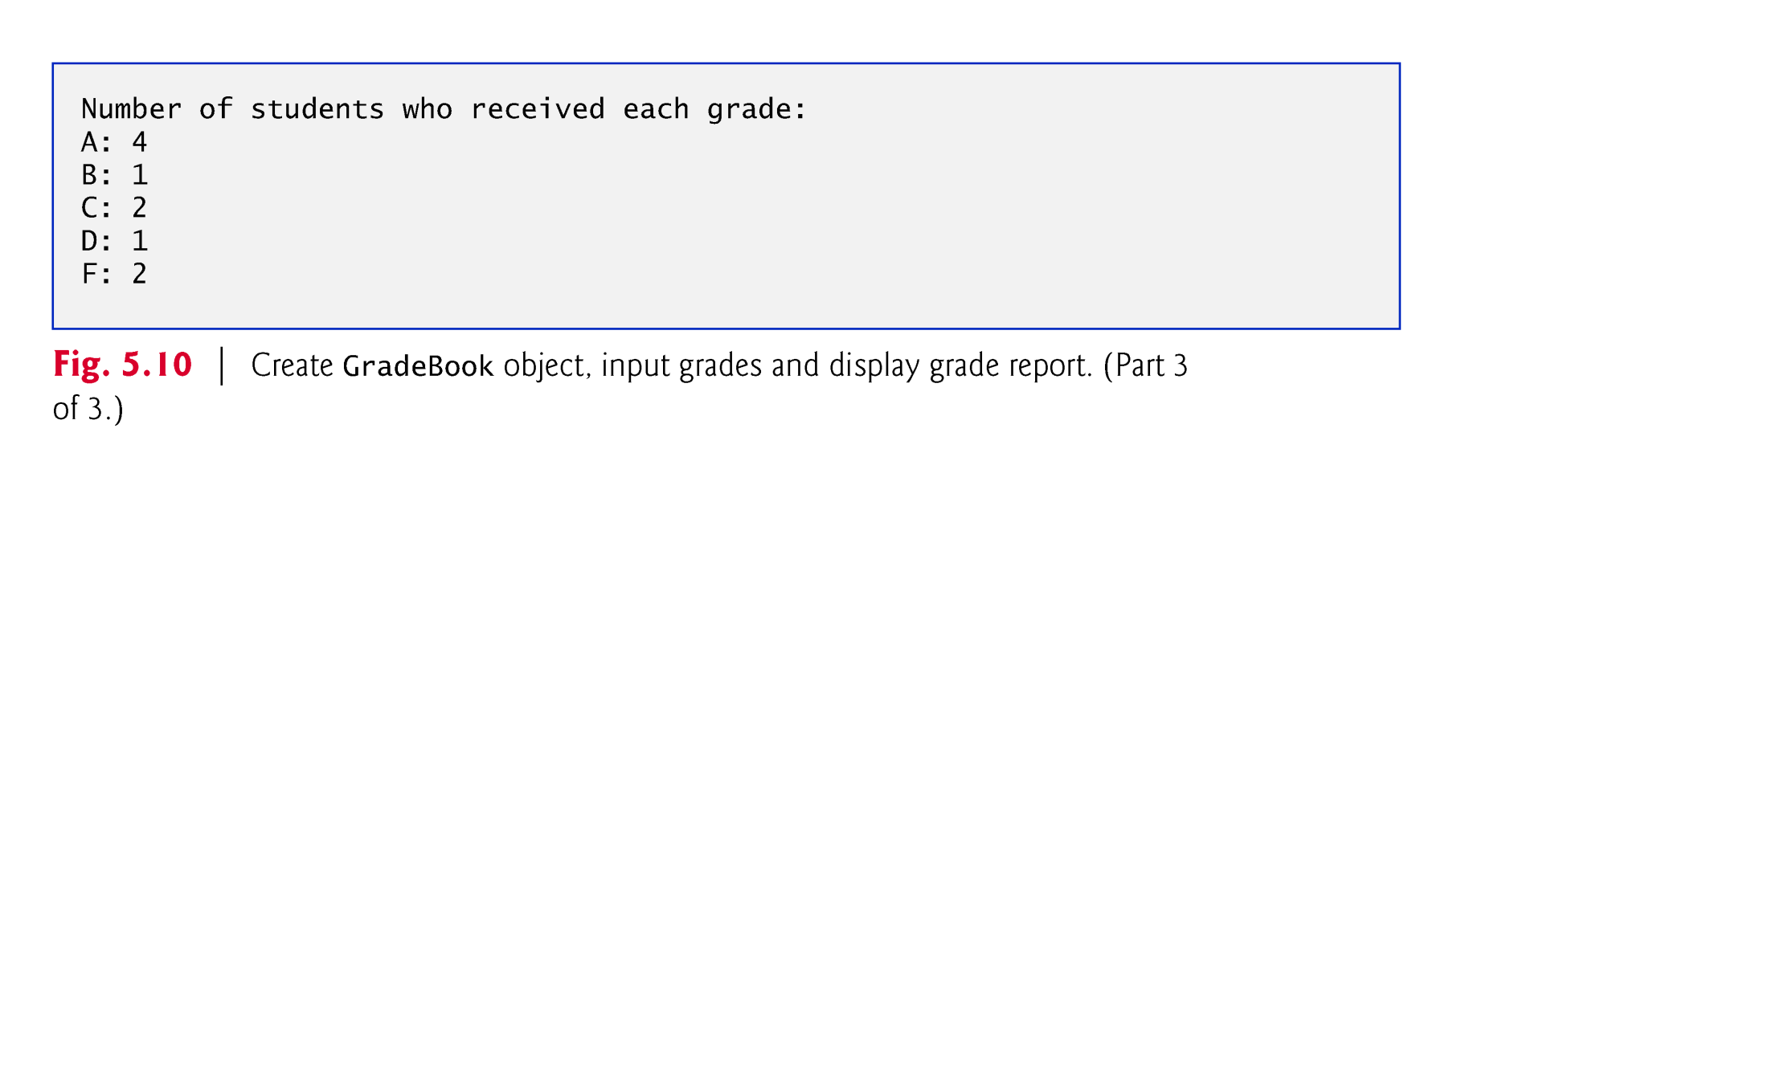

Slide 37
5.6 switch Multiple-Selection Statement (Cont.)
The end-of-file indicator is a system-dependent keystroke combination which the user enters to indicate that there is no more data to input.
On UNIX/Linux/Mac OS X systems, end-of-file is entered by typing the sequence
<Ctrl> d
On Windows systems, end-of-file can be entered by typing
<Ctrl> z
Windows typically displays the characters ^Z on the screen when the end-of-file indicator is typed.

Slide 38
5.6 switch Multiple-Selection Statement (Cont.)
Scanner method hasNext determine whether there is more data to input. This method returns the boolean value true if there is more data; otherwise, it returns false.
As long as the end-of-file indicator has not been typed, method hasNext will return true.

Slide 39
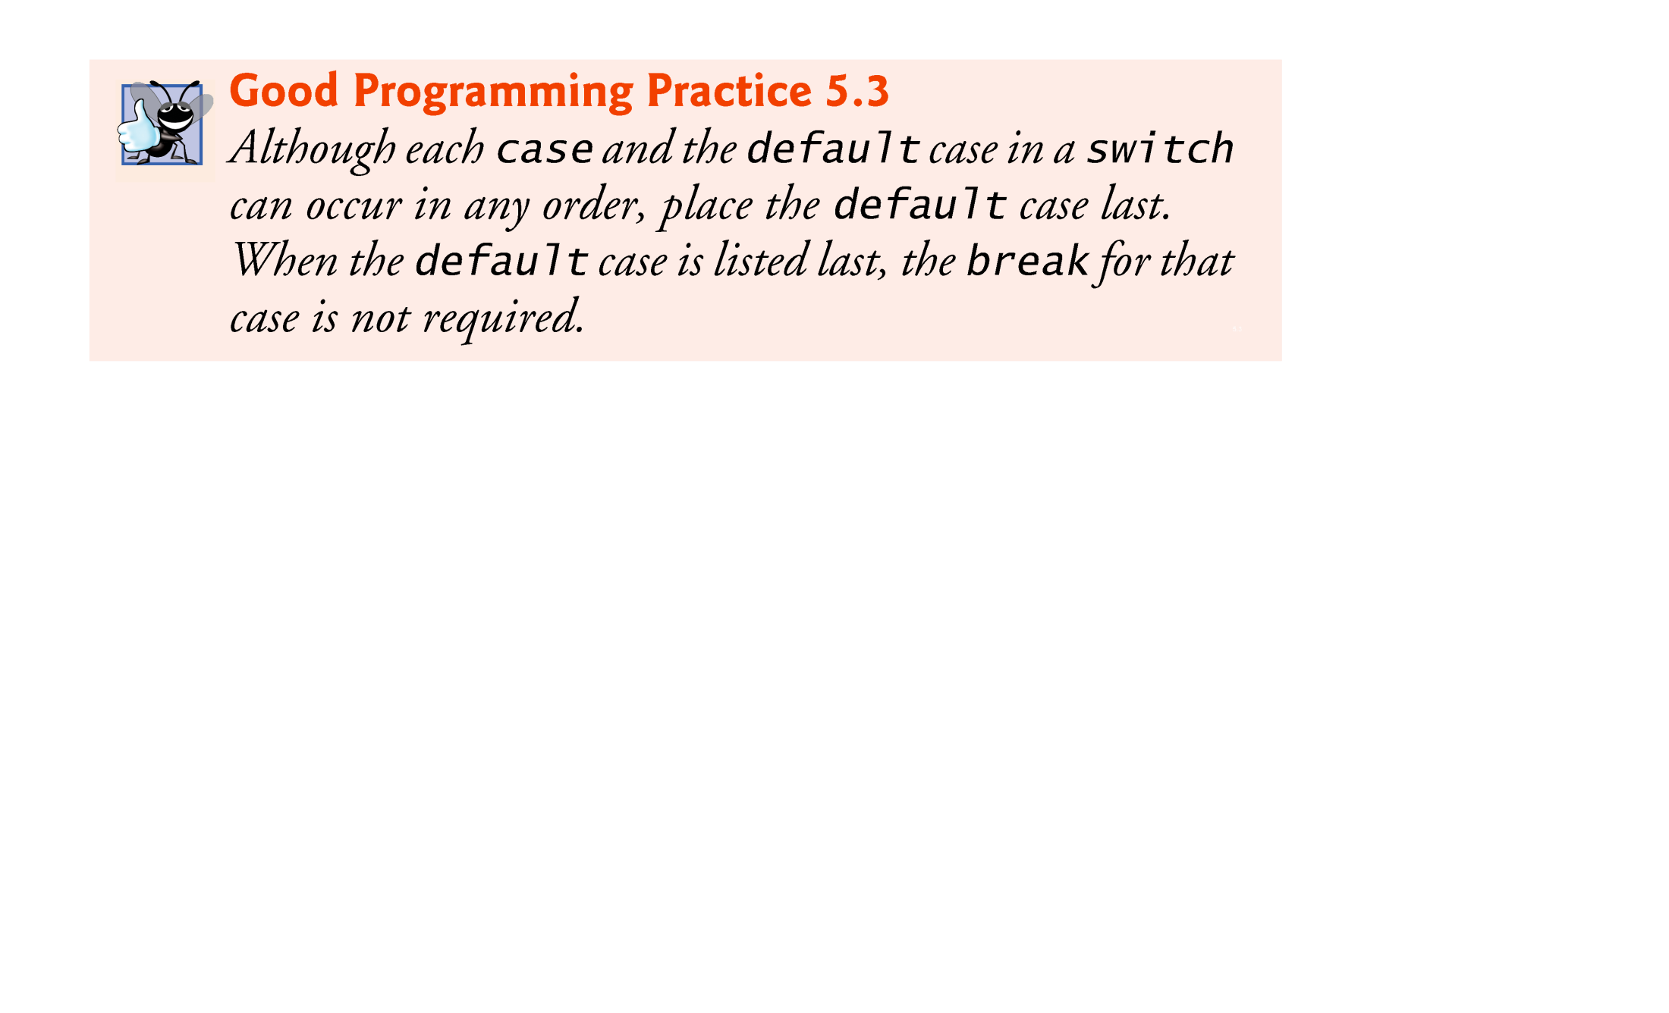
5.6 switch Multiple-Selection Statement (Cont.)
If no match occurs between the controlling expression’s value and a case label, the default case executes.
If no match occurs and there is no default case, program control simply continues with the first statement after the switch.

Slide 40
5.6 switch Multiple-Selection Statement (Cont.)
you can use character constants—specific characters in single quotes, such as 'A', '7' or '$'—which represent the integer values of characters.
The expression in each case can also be a constant variable—a variable that contains a value which does not change for the entire program. Such a variable is declared with keyword final.
Java has a feature called enumerations. Enumeration constants can also be used in case labels.

Slide 41
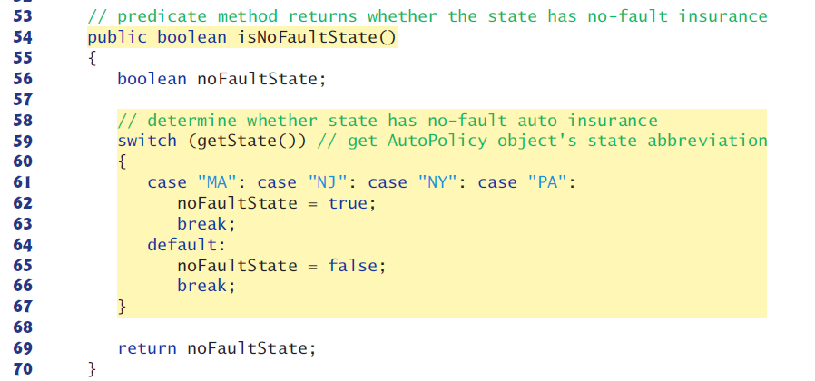
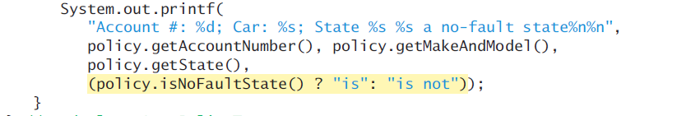
5.7 Strings in switch Statements

Slide 42
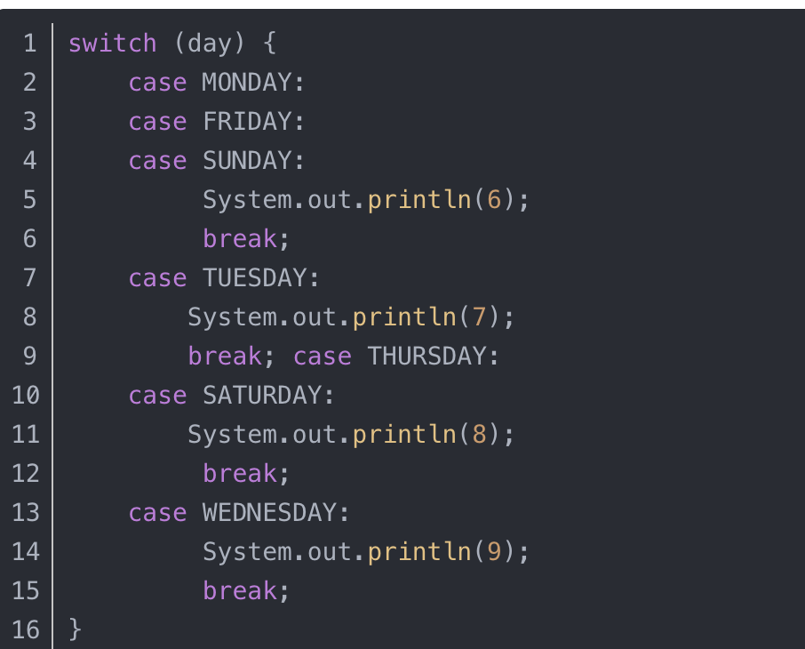
jdk11 and earlier：

Slide 43
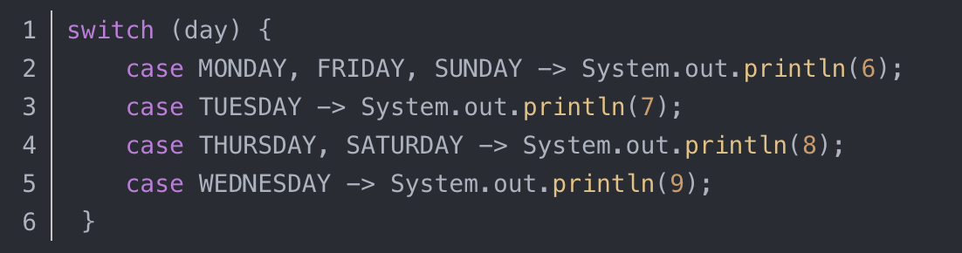
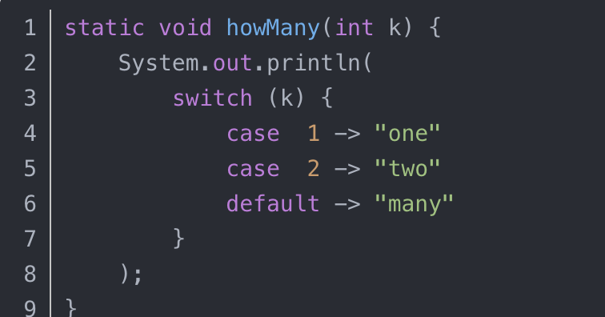
JDK12：
JDK13：

Slide 44
5.8 break and continue Statements
The break statement, when executed in a while, for, do…while or switch, causes immediate exit from that statement.

Slide 45
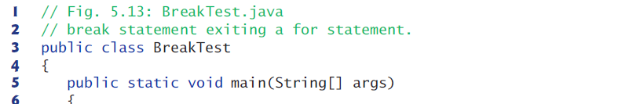
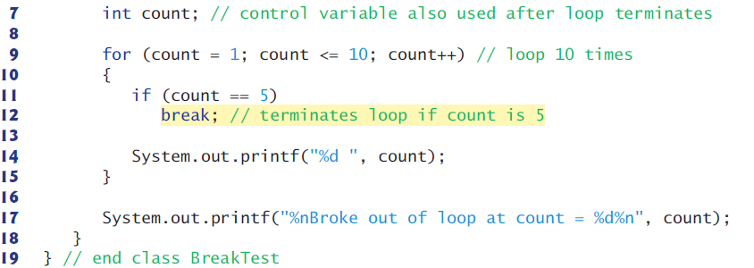
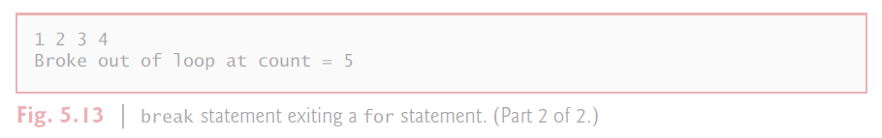

Slide 46
5.8 break and continue Statements (Cont.)
The continue statement, when executed in a while, for or do…while, skips the remaining statements in the loop body and proceeds with the next iteration of the loop.

Slide 47
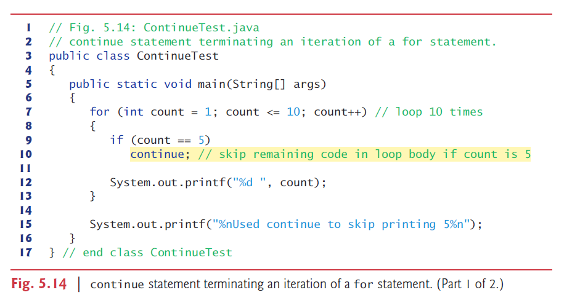
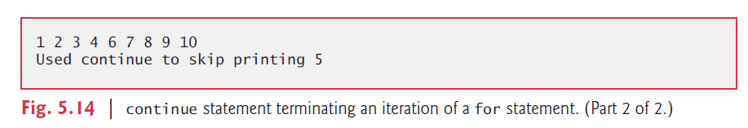

Slide 48
5.9 Logical Operators
Java’s logical operators enable you to form more complex conditions by combining simple conditions.
The logical operators are
&& (conditional AND)
|| (conditional OR)
& (boolean logical AND)
| (boolean logical inclusive OR)
^ (boolean logical exclusive OR)
! (logical NOT).
[Note: The &, | and ^ operators are also bitwise operators when they are applied to integral operands.]

Slide 49
5.9 Logical Operators (Cont.)
The parts of an expression containing && or || operators are evaluated only until it’s known whether the condition is true or false. T
This feature of conditional AND and conditional OR expressions is called short-circuit evaluation.

Slide 50
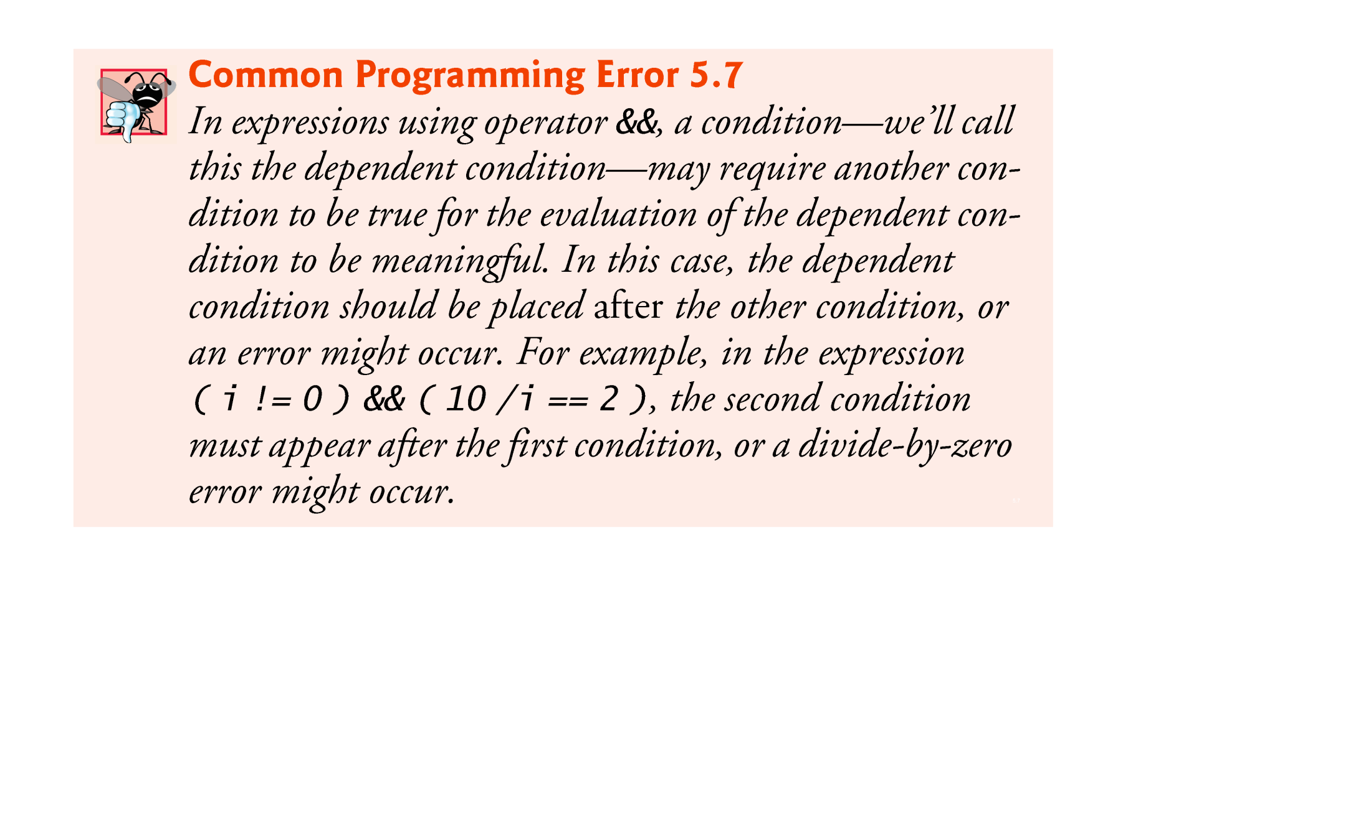

Slide 51
5.9 Logical Operators (Cont.)
The %b format specifier displays the word “true” or the word “false” based on a boolean expression’s value.

Slide 52
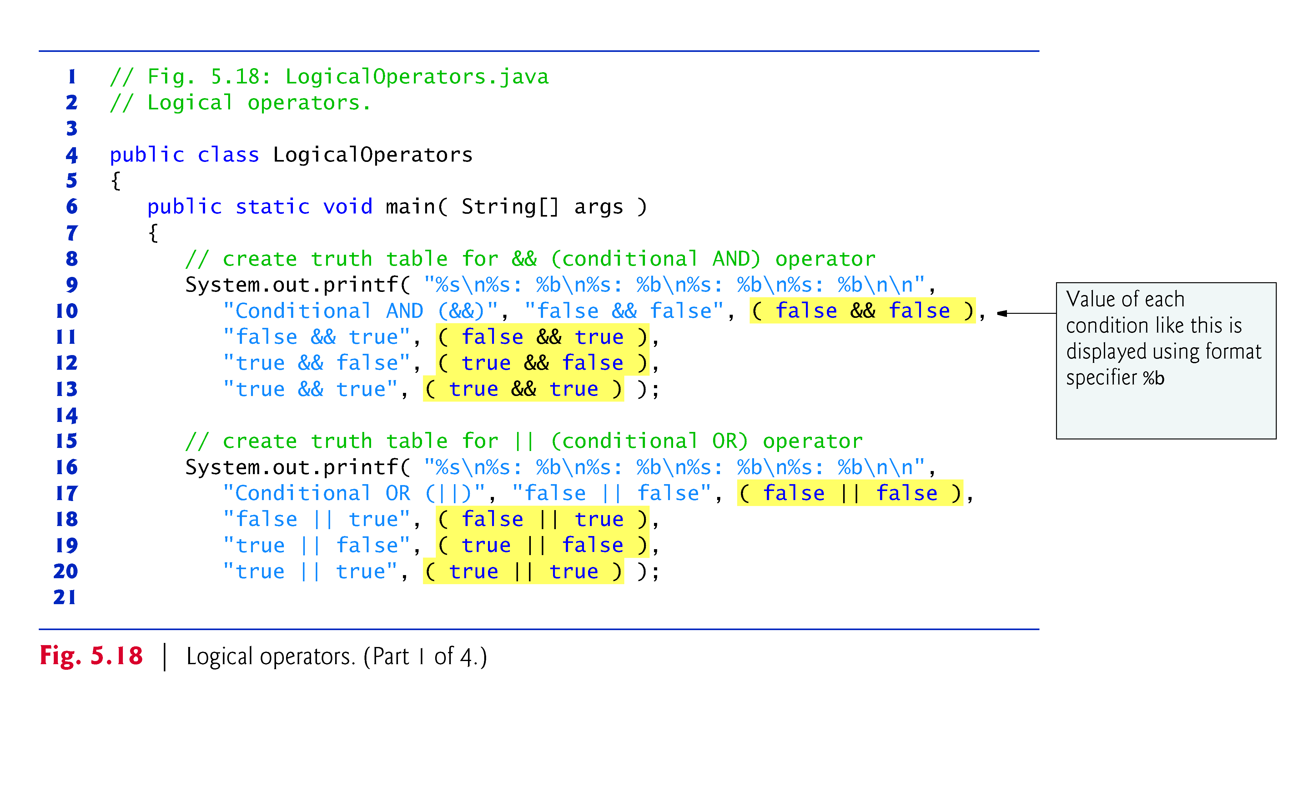

Slide 53
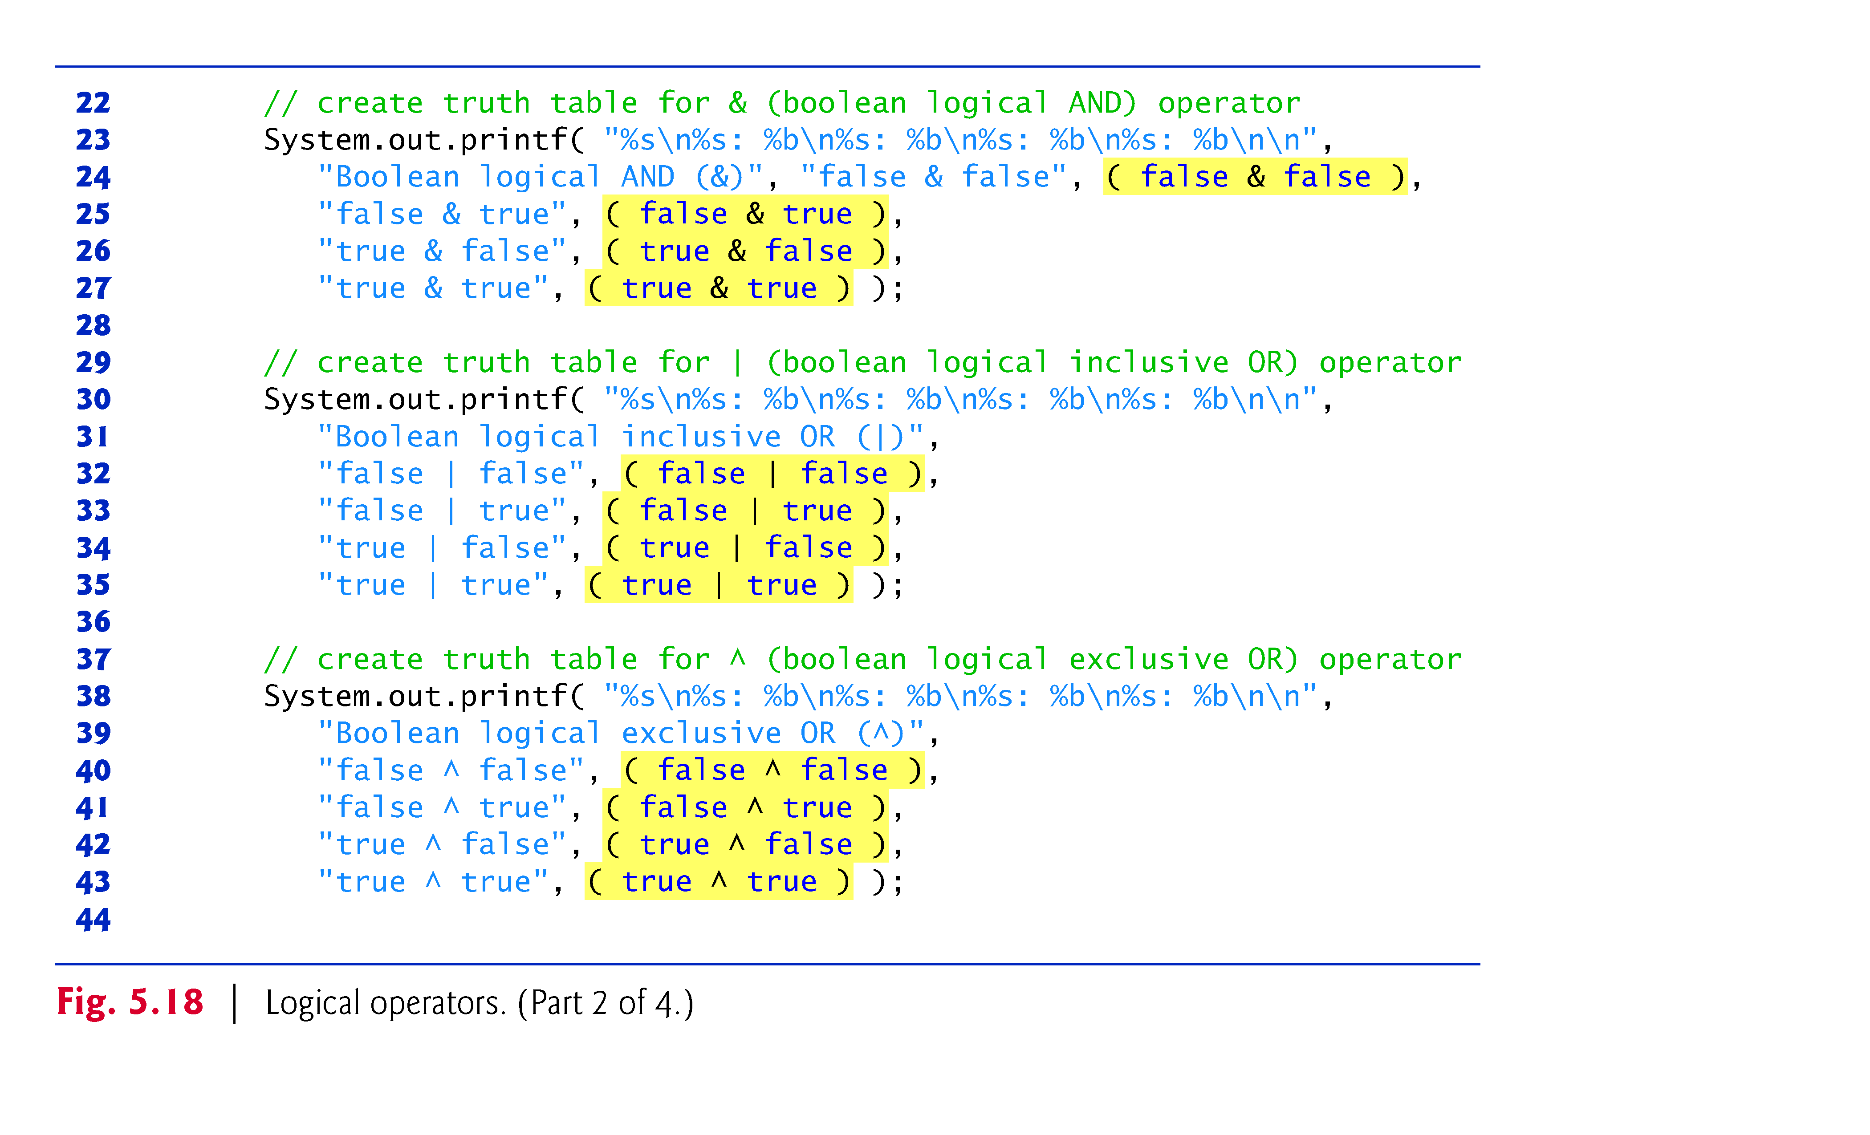

Slide 54
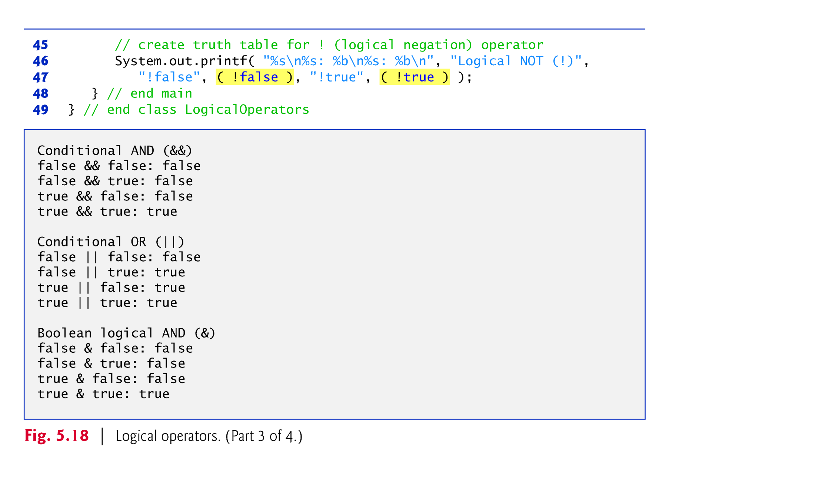

Slide 55
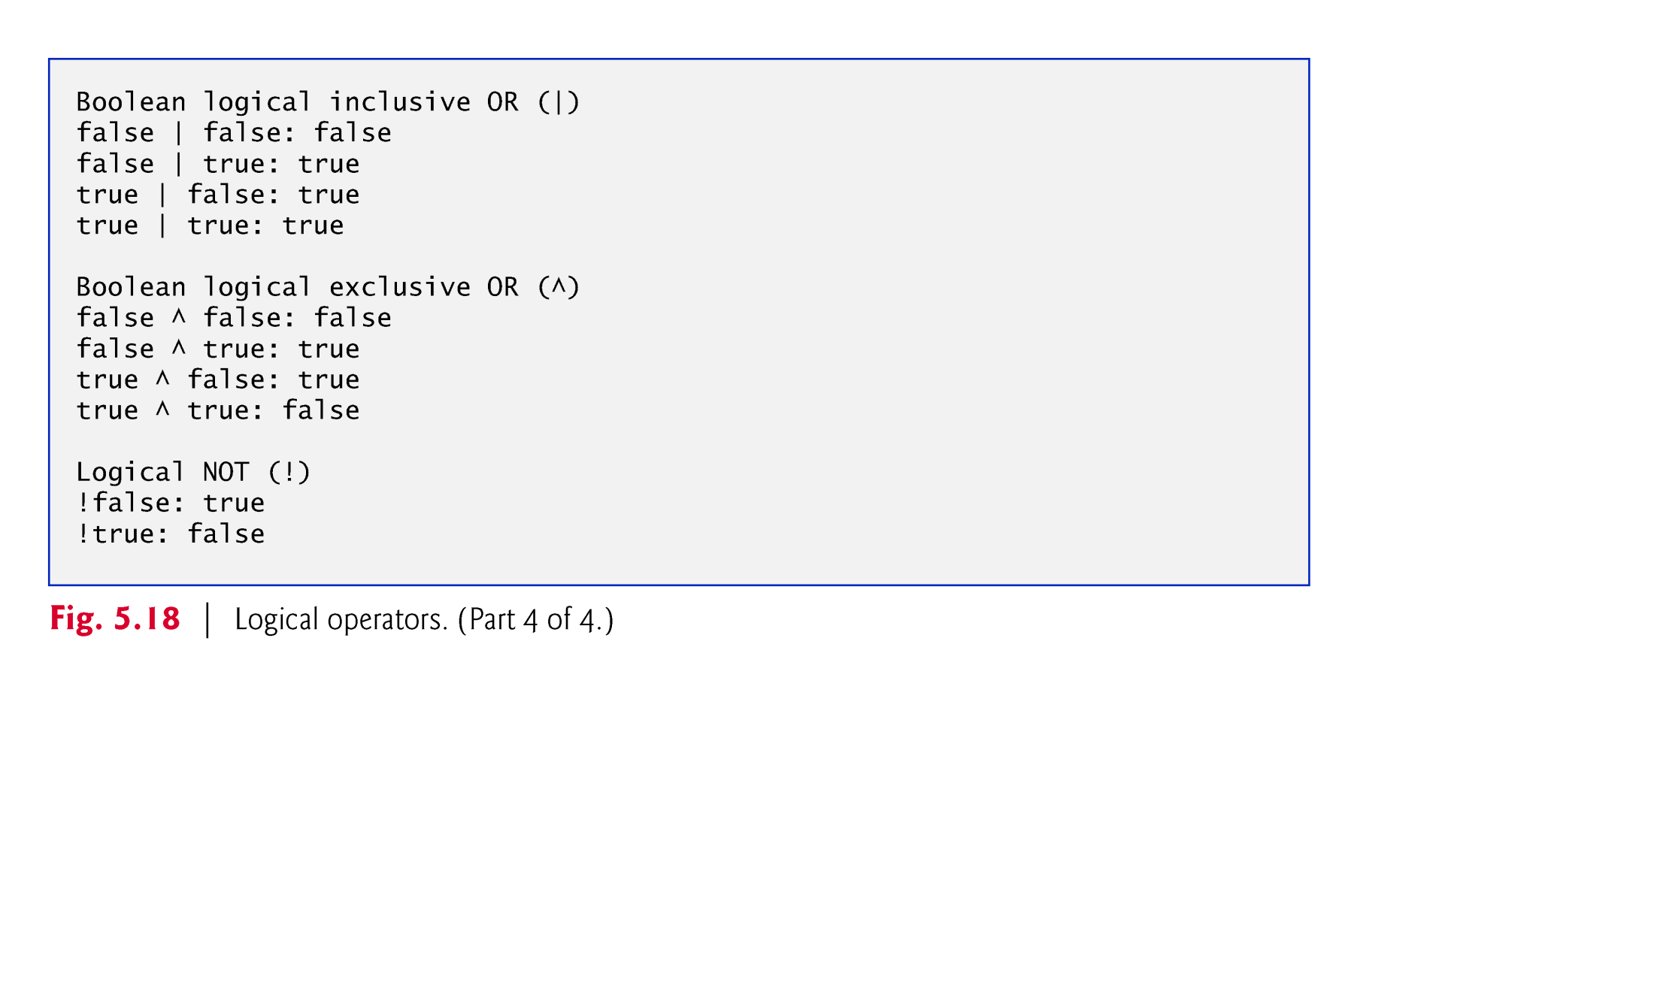

Slide 56
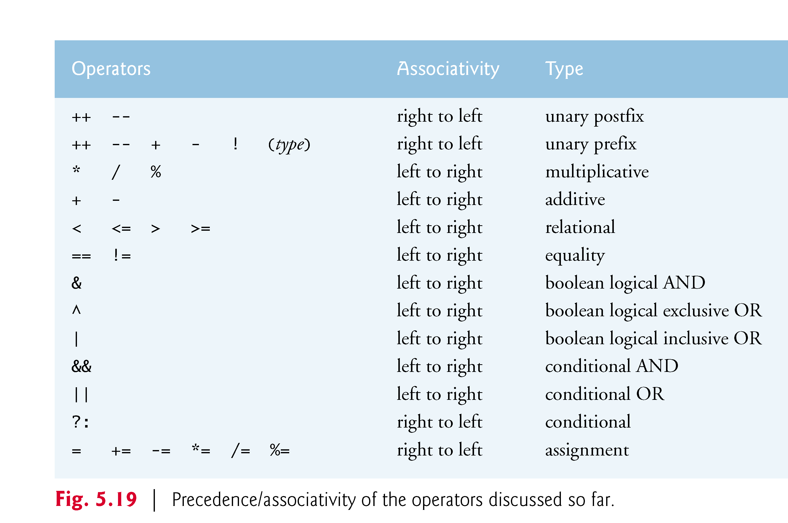

Slide 57
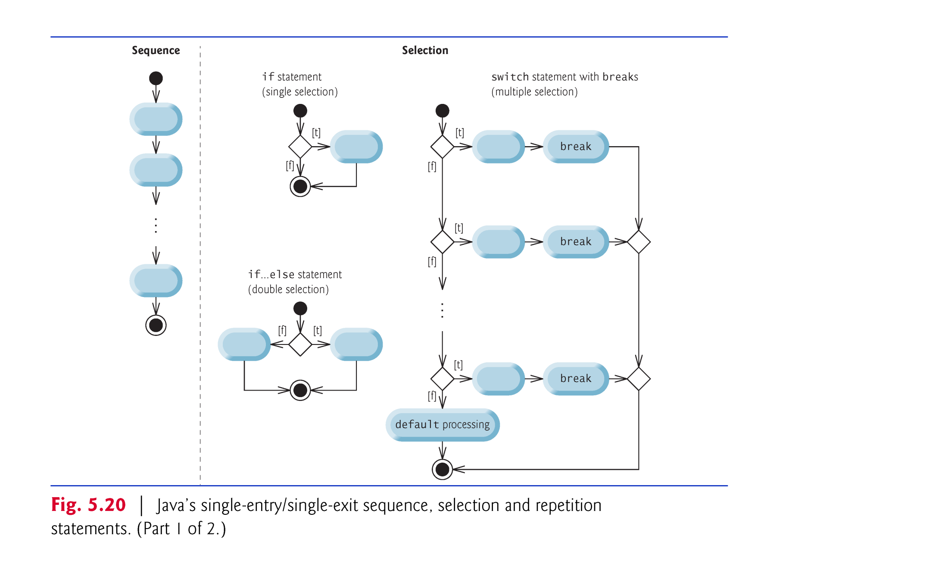
5.10 Structured Programming Summary

Slide 58
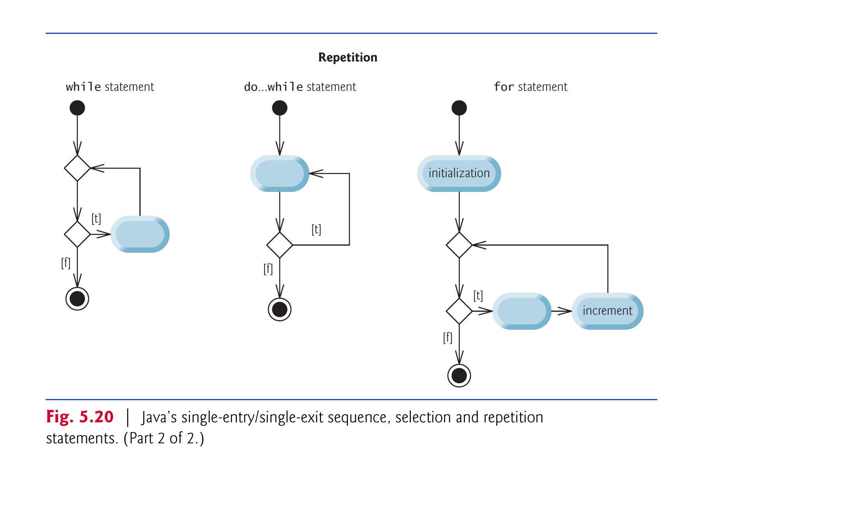

Slide 59
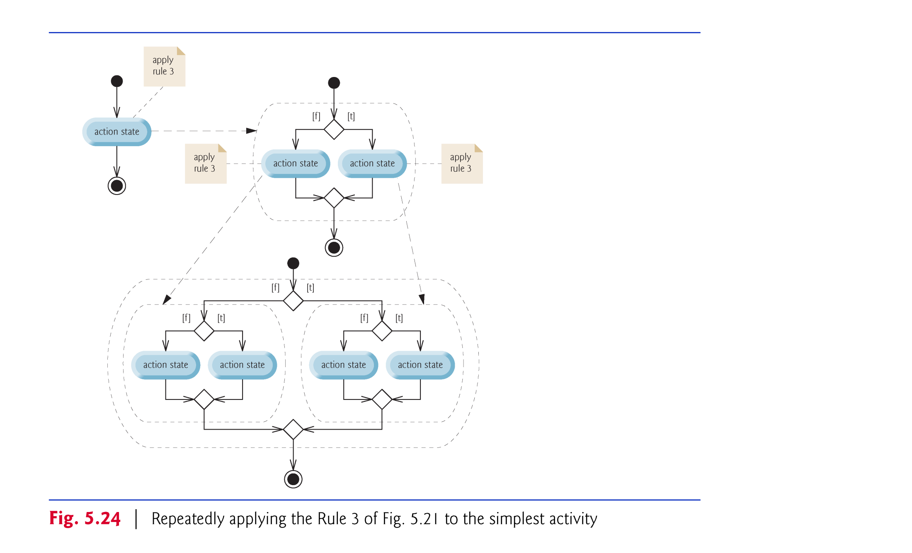

Slide 60
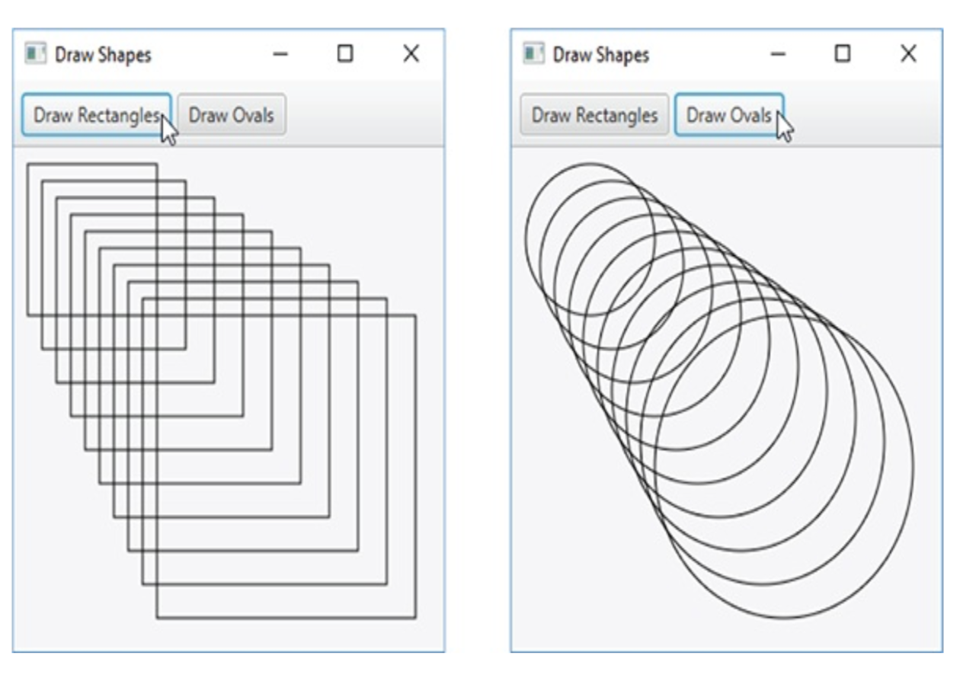
5.11 (Optional) GUI and Graphics Case Study: Drawing Rectangles and Ovals

Slide 61
5.11 (Optional) GUI and Graphics Case Study: Drawing Rectangles and Ovals(Cont.)
For the Button, set the following properties:
text——Draw Rectangle
On Action——drawRectanglesButtonPressed
For the second Button, set the following properties:
text——Draw Oval
On Action—— drawOvalsButtonPressed

Slide 62
5.11 (Optional) GUI and Graphics Case Study: Drawing Rectangles and Ovals (Cont.)
As in the prior Java FX example, this app has two Java source-code files:
DrawShapes.java contains the JavaFX app’s main application class that loads DrawShapes.fxml and configures the DrawShapesController.
DrawShapesController.java contains the controller class that draws either rectangles or ovals, based on which Button the user presses.

Slide 63
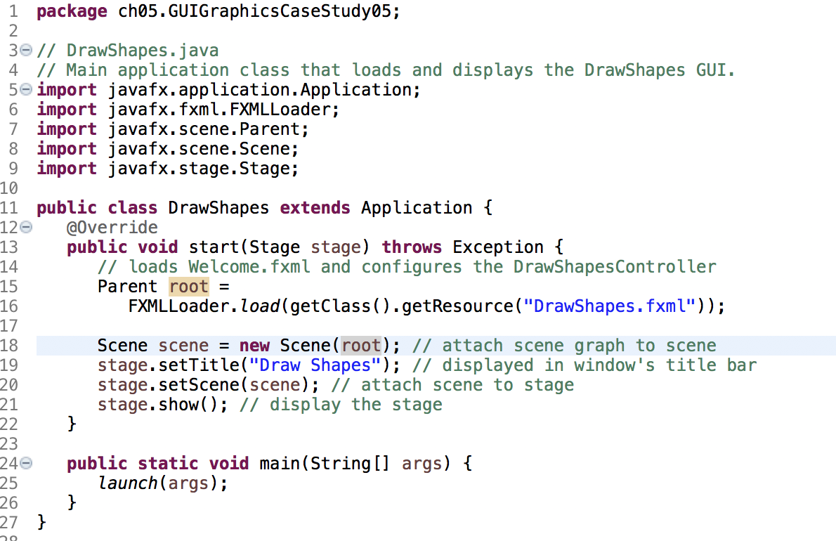

Slide 64
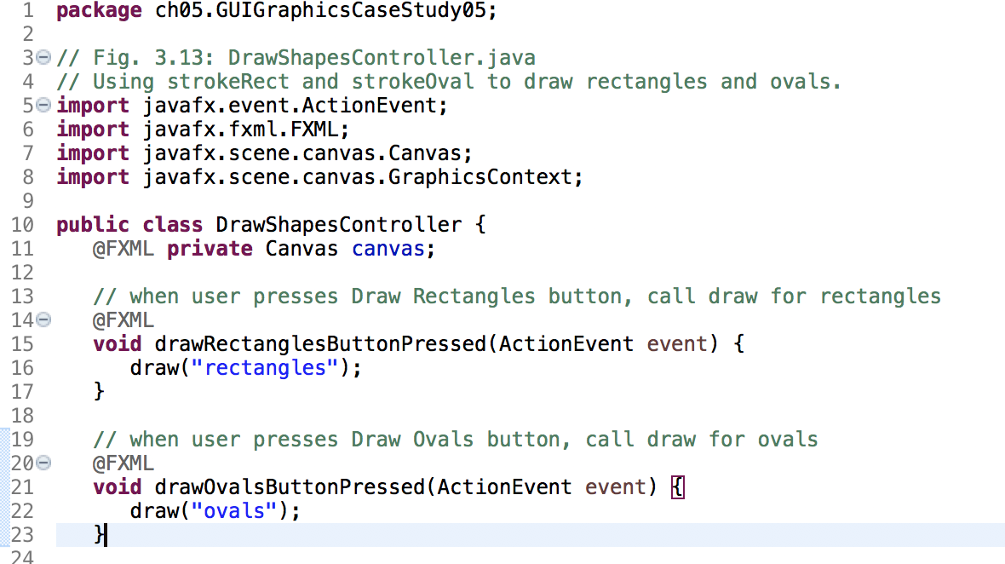

Slide 65
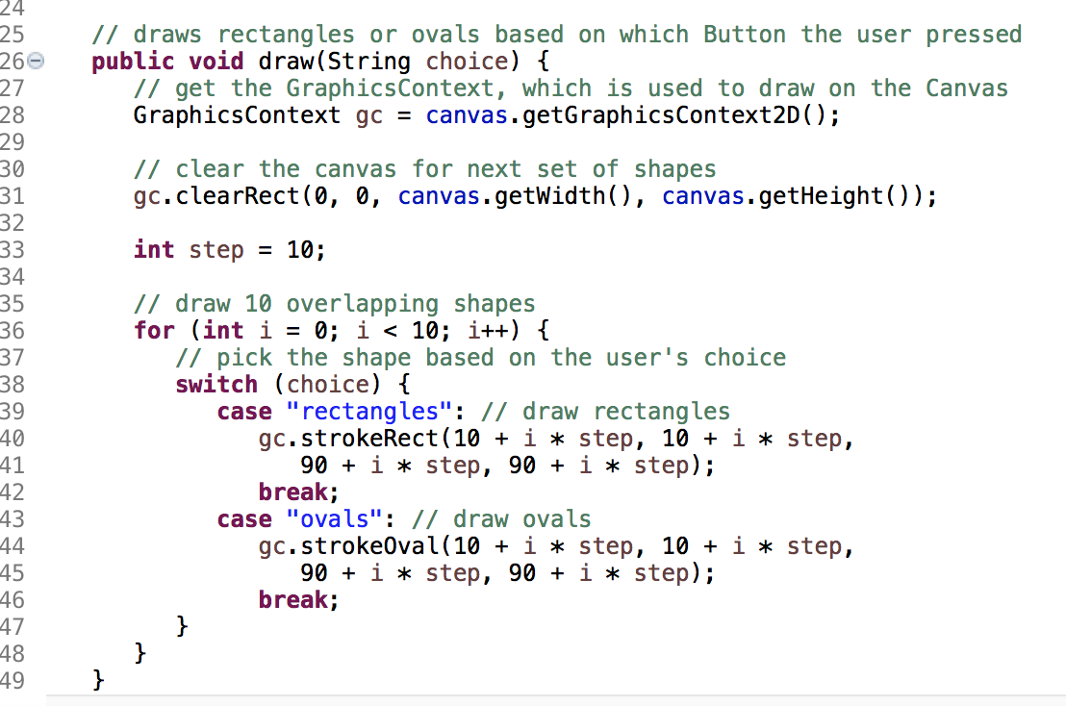

Slide 66
5.11 (Optional) GUI and Graphics Case Study: Drawing Rectangles and Ovals (Cont.)
Method clearRect of GraphicsContext clears any prior drawing
Method strokeOval of GraphicsContext draws ovals.
Mehtod strokeRect of GraphicsContext draws rectangles.

